Slide 1
IMD in Transmitter Circuits
WA1MBA
Tom Williams
2024 NEWS VHF Conference

Slide 2
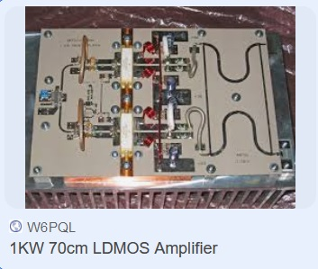
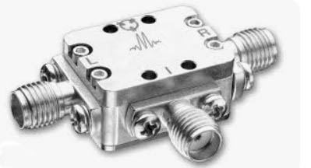
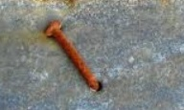
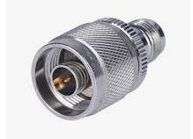
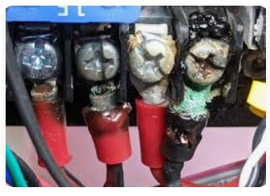
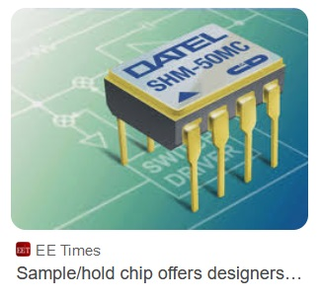
QUIZ
WHICH OF THESE IS A MIXER?
Marki
Microwave
Mixer
Quality
LDMOS
Power
Amp
Rusty Nail
In Sheet
Metal
Pencil
On
Metal
Coax
Connector
Sample
And Hold
Circuit
Corroded
Connection

Slide 3
QUIZ
* A Mixer is a Mixer
WHICH OF THESE IS A MIXER?
Marki
Microwave
Mixer
Quality
LDMOS
Power
Amp
Rusty Nail
In Sheet
Metal
Pencil
On
Metal
Coax
Connector
Sample
And Hold
Circuit
Corroded
Connection

Slide 4
QUIZ
WHICH OF THESE IS A MIXER?
Marki
Microwave
Mixer
Quality
LDMOS
Power
Amp
Rusty Nail
In Sheet
Metal
Pencil
On
Metal
Coax
Connector
Sample
And Hold
Circuit
Corroded
Connection

Slide 5
QUIZ
Dissimilar metals and oxides
Create RF diodes
WHICH OF THESE IS A MIXER?
Marki
Microwave
Mixer
Quality
LDMOS
Power
Amp
Rusty Nail
In Sheet
Metal
Pencil
On
Metal
Coax
Connector
Sample
And Hold
Circuit
Corroded
Connection

Slide 6
QUIZ
Dissimilar metals and oxides
Create RF diodes
WHICH OF THESE IS A MIXER?
Marki
Microwave
Mixer
Quality
LDMOS
Power
Amp
Rusty Nail
In Sheet
Metal
Pencil
On
Metal
Coax
Connector
Sample
And Hold
Circuit
Corroded
Connection

Slide 7
QUIZ
Non-linear devices mix signals
WHICH OF THESE IS A MIXER?
Marki
Microwave
Mixer
Quality
LDMOS
Power
Amp
Rusty Nail
In Sheet
Metal
Pencil
On
Metal
Coax
Connector
Sample
And Hold
Circuit
Corroded
Connection

Slide 8
QUIZ
Ferrous metal in an RF
path can be non-linear
WHICH OF THESE IS A MIXER?
Marki
Microwave
Mixer
Quality
LDMOS
Power
Amp
Rusty Nail
In Sheet
Metal
Pencil
On
Metal
Coax
Connector
Sample
And Hold
Circuit
Corroded
Connection

Slide 9
QUIZ
Switches are Mixers
(the extreme case of
Nonlinearity)
WHICH OF THESE IS A MIXER?
Marki
Microwave
Mixer
Quality
LDMOS
Power
Amp
Rusty Nail
In Sheet
Metal
Pencil
On
Metal
Coax
Connector
Sample
And Hold
Circuit
Corroded
Connection

Slide 10
Mixers are Nonlinear Devices the best of which are high speed switches
Designed and Intended Mixers
Nonlinearities in / from
Diodes including
Packaged Diodes
Corroded connections
Transistors
Bipolar
FET (MSEFET, LDMOS, etc)
Ferrous material in the RF path
Switches (if switched at an LO frequency)

Slide 11
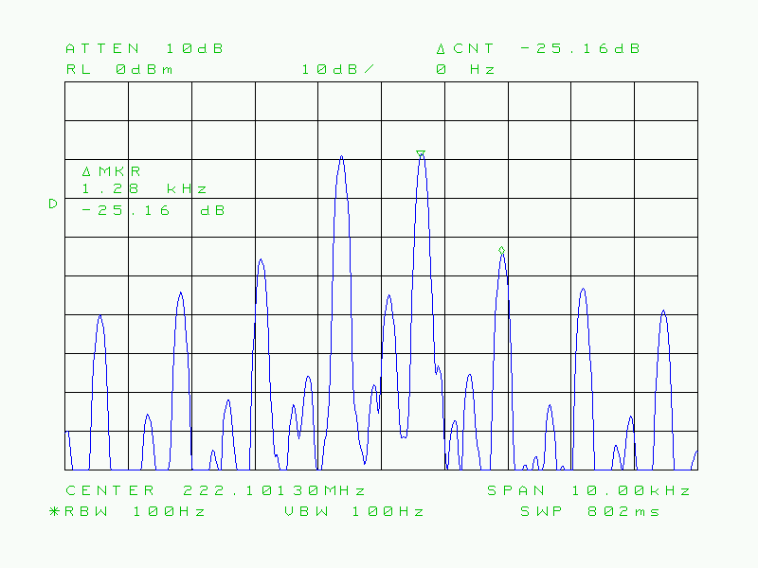
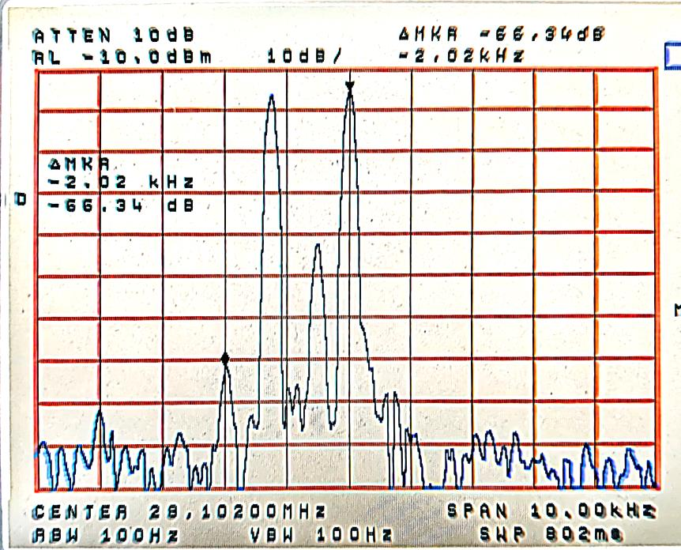
Inter Modulation Distortion
A distortion caused by the MIXING of frequencies which are not intended to be mixed

Slide 12
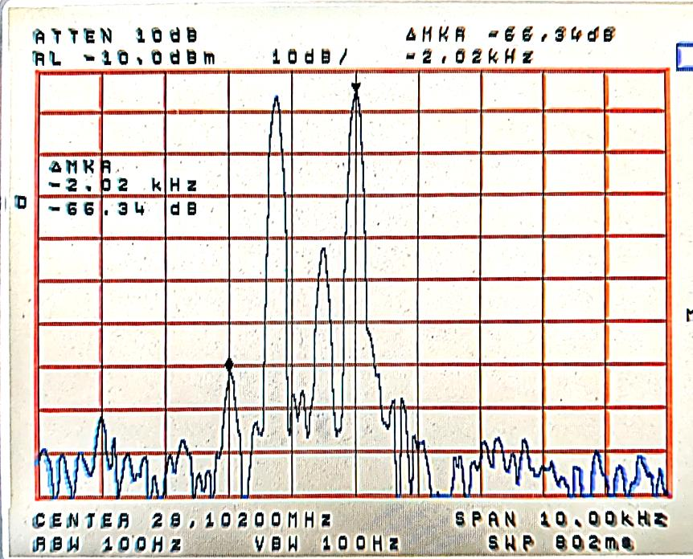
Inter Modulation Distortion
Lower, more negative numbers are better, expressed as -XXdBc
-20 dBc
-80 dBc
INPUT
OUTPUT

Slide 13
Inter Modulation Distortion
A distortion caused by the MIXING of frequencies which are not intended to be mixed
Every mixer will mix every signal and create what we call IMD Which are products we don’t want
Reduction of unwanted mixing products is the same as reduction of IMD - BUT
The difficult products are those in and around the transmitted signal, and cannot be filtered
So the only way to reduce them is to prevent or reduce their generation

Slide 14
Hold on – mixing those two 222 MHz frequencies will make products way up at 444 MHz and down near DC – What gives?
1,300 Hz
1,300 Hz
1,300 Hz
1,300 Hz
1,300 Hz

Slide 15
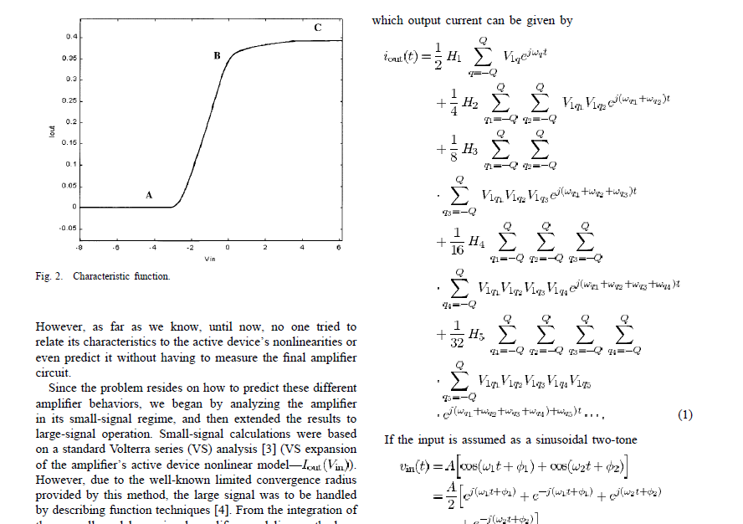
Now Billy, this is your exam for 8th grade Arithmetic. What Mixing Products are in the Passband?

Slide 16
It’s really Much Simpler
Mixers generate not only LO + IF and LO – IF (generally what we want) but also 2xLO+IF, 2xLO – IF, 2xLO + 2xIF, 2xLO-2xIF, and so on.
Given a 700 Hz and a 2000 Hz tone USB at 222.100 MHz
One of the products is (2xLO+2xIF₂) - (LO+F₁)
(2xLO+2xIF₂) is 2x194 =388 + 56.2040 = 444.2040 MHz
(LO+F₁) = 194 + 28.1007 = 222.1007 MHz
The product is 444.2040 – 222.1007 = 222.1033
222.1033 is 1300 Hz above the IF₂ signal at 222.1020
Similar arithmetic generates all the IMD tones at 1300 Hz spacing

Slide 17
SPOILER ALERT – NO MOREMATH

Slide 18
Typical (bad) VHF Transmitter Chain
Amps, Mixer, LO, Gain, Filters, Amplifier
WA1MBA PRESENT STATION
FLEX Transceiver, Old DEMI Transverter, Mirage AMP
-12 dBc SSB is bad, and that is running at ½ power
Transceiver
Transverter
Amplifier
Filters,
Coax, Ant
Frequency
Power dBm
Power Watts
IMD dBc
Can it be worse?
28 MHz
+0dBm
1 milliwatt
IMD almost
Unmeasurable
-80dBc
222 MHz
+40dBm
10 Watts
IMD
-14.5
Capable of
20 W
222 MHz
+47dBm
50 Watts
IMD -12 dBc
Mr. Splatter
Capable of
100W

Slide 19
2 Things to Reduce IMD
Properly Terminate Mixers (ALL MIXERS)
Operate all devices, especially including Power Amplifiers in their Most Linear Region

Slide 20
To reduce unwanted mixer products properly terminate IF and RF ports
Minicircuits makes a few such filters for some IF frequency ranges, including 28 MHz
Had to make my own for the RF port 222 MHz
I am not a great RF Filter Designer, so took a simple filter approach

Slide 21
Constant Impedance Filter A

Slide 22
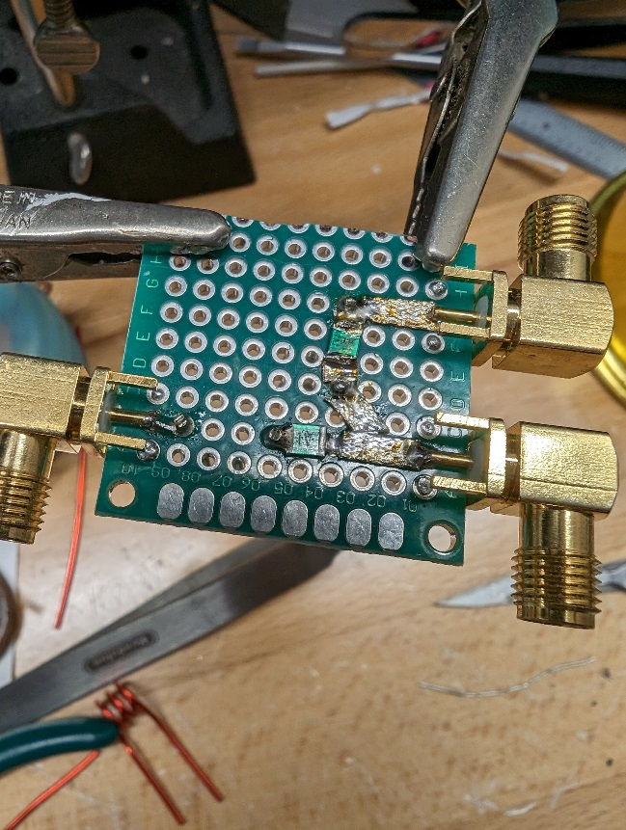
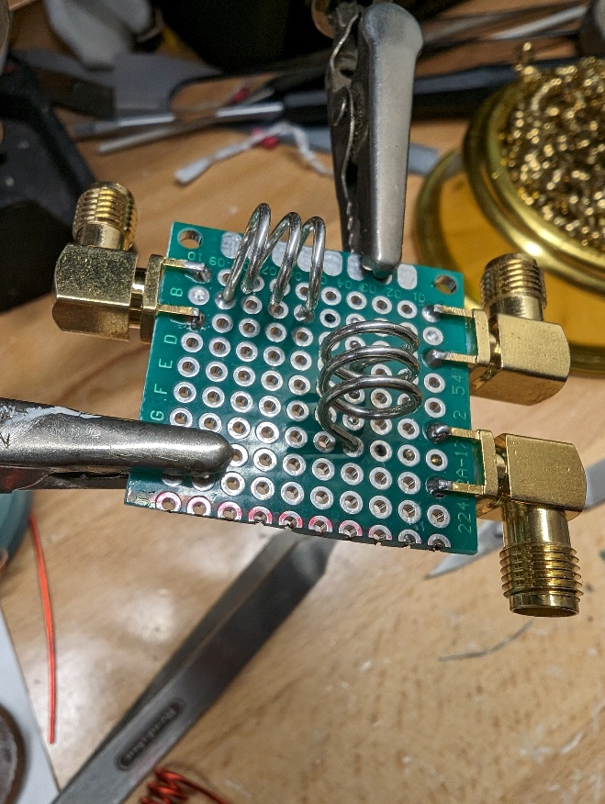
Construction

Slide 23
Cascading Filter A

Slide 24
Getting it to work

Slide 25
Cascading and Tuning did OK

Slide 26
Constant Impedance Filter B

Slide 27
Built

Slide 28
Cascading Filter B

Slide 29
Getting it to work

Slide 30
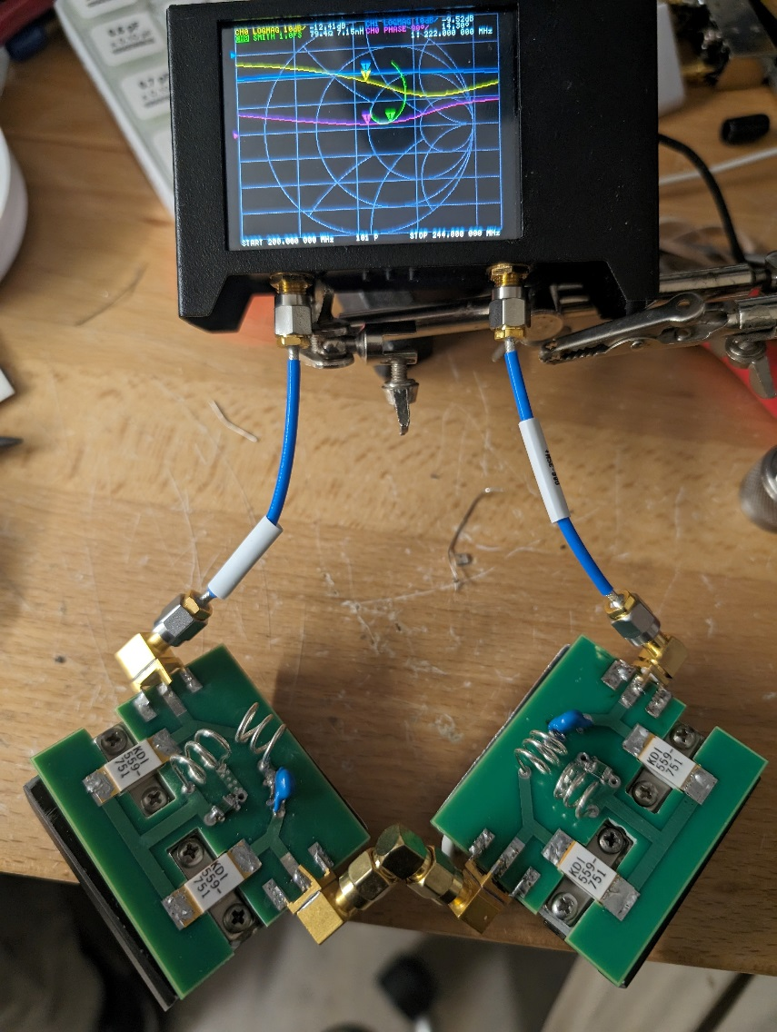
It worked OK but not Great

Slide 31
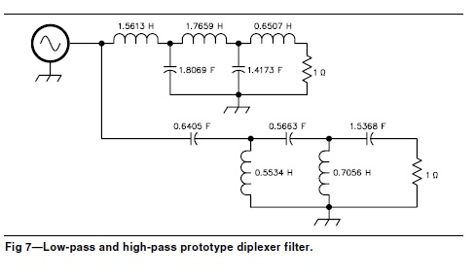
Constant Impedance Filter C Diplexer (with load)

Slide 32
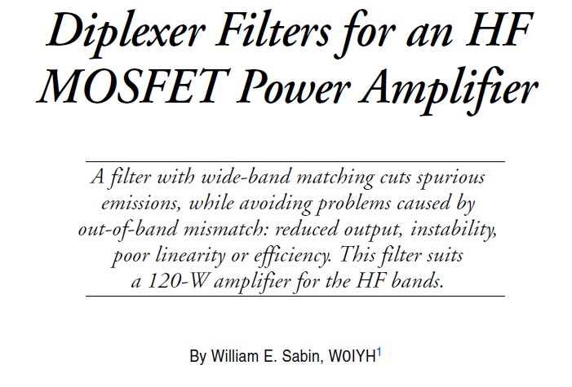
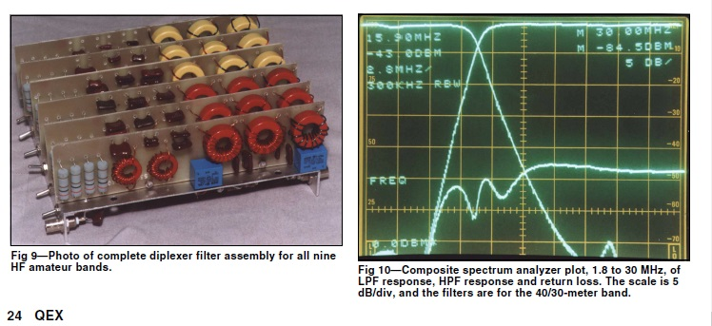
Diplexer/Constant Impedance High Power Filters
QEX July/August 1999, William Sabin W0IYH (SK)

Slide 33
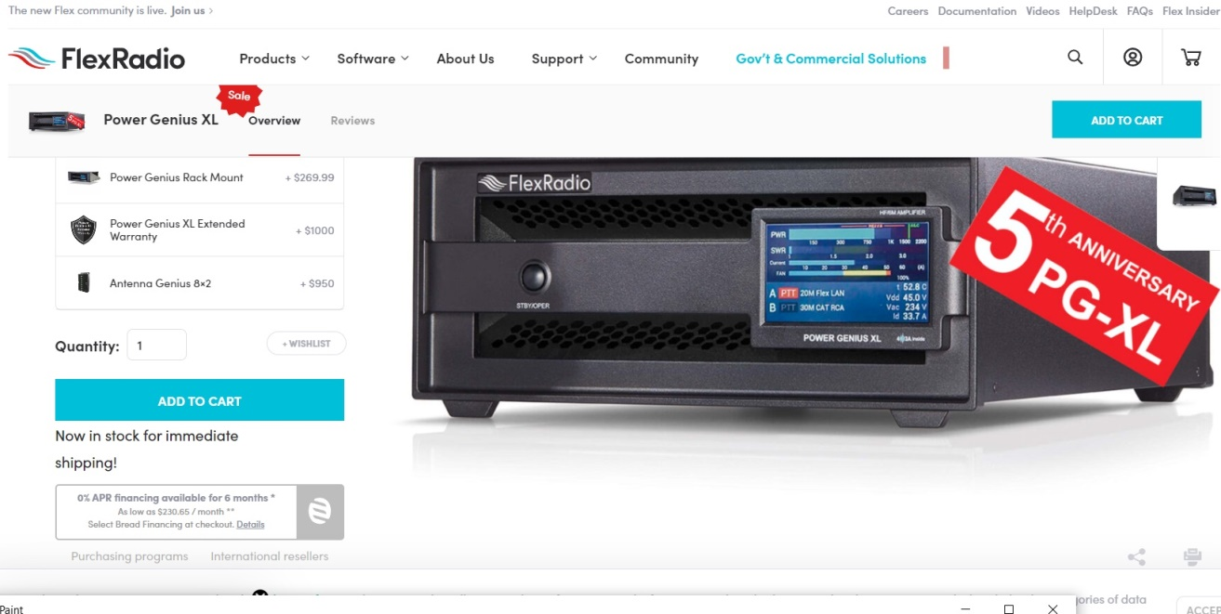
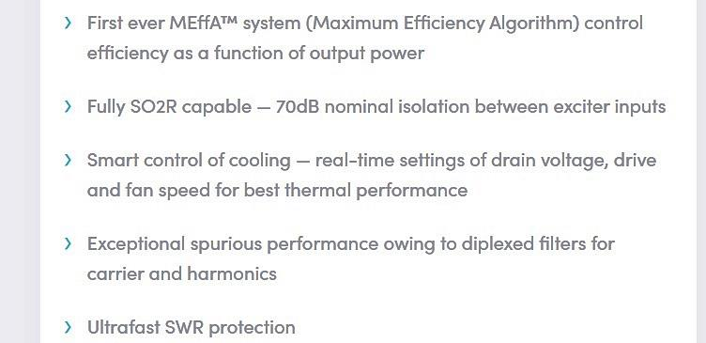
FLEX Power Genius HF PA

Slide 34
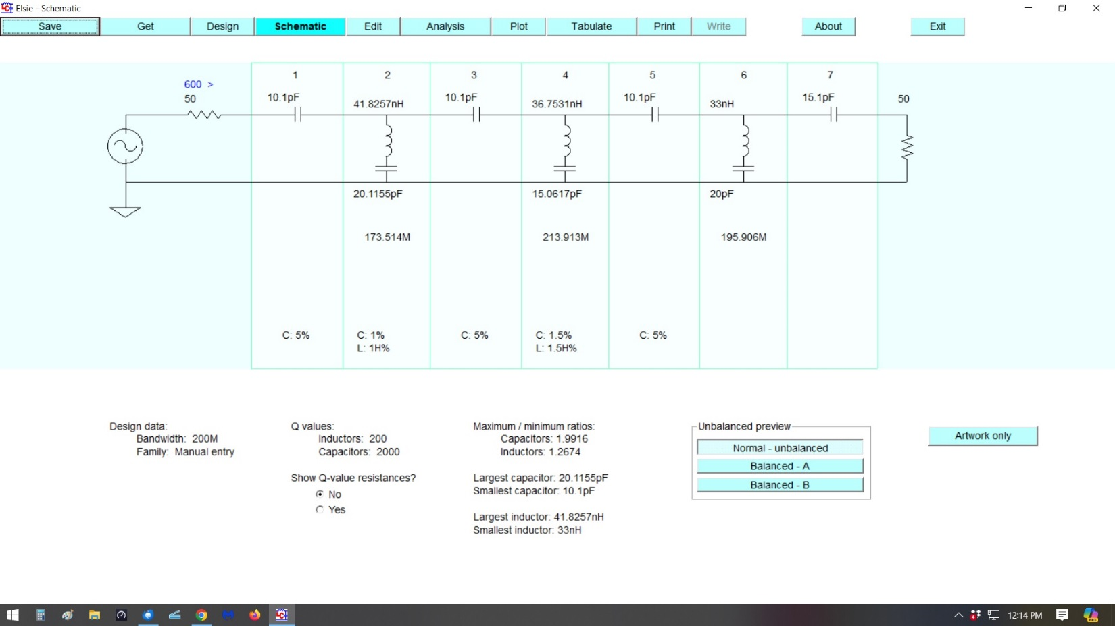
Design of HPF

Slide 35
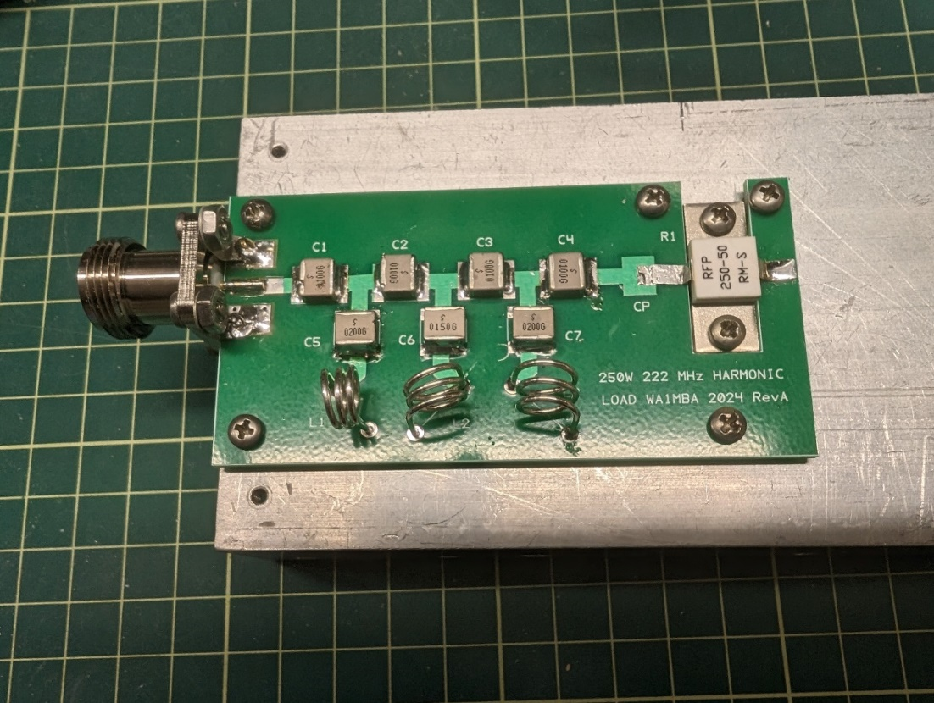
Build a nice high power HPF
SEE THE PRETTY NPO 3.6KV 10 AMP CAPS? $$
SEE THE PRETTY SILVER WIRE? $$
SEE THE HAM WIHTOUT AN ENGINEERING DEGREE?
PARASITICS SWAMPED THE CIRCUIT, NO GOOD.

Slide 36
That was 2 days ago
Not working yet
Probably have to design both HP and LP together (a “contiguous diplexer”)
Found that parasitics – primarily capacitance –were overwhelming the as-built
So, a lot more to do
Anyway, I have some filters to play with in test circuits

Slide 37
So Much for Filters How about Linearity?

Slide 38
LDMOS Power Amplifiers
N4GA – Bob Go to: n4ga.com
Avoid power levels into compression
Operate at AB or A. Try 1 AMP per device idle current (1 Amp each side of a dual part) but possibly increase up to 4 Amps each side
Note – that is 100 to 400 Watts of IDLE POWER
Push Pull amplifiers, so have to Balance Idle Current for MINIMUM EVEN HARMONICS
Stabilize Bias Current (over temperature)
RUN at high voltage (e.g. 50V not 48V)

Slide 39
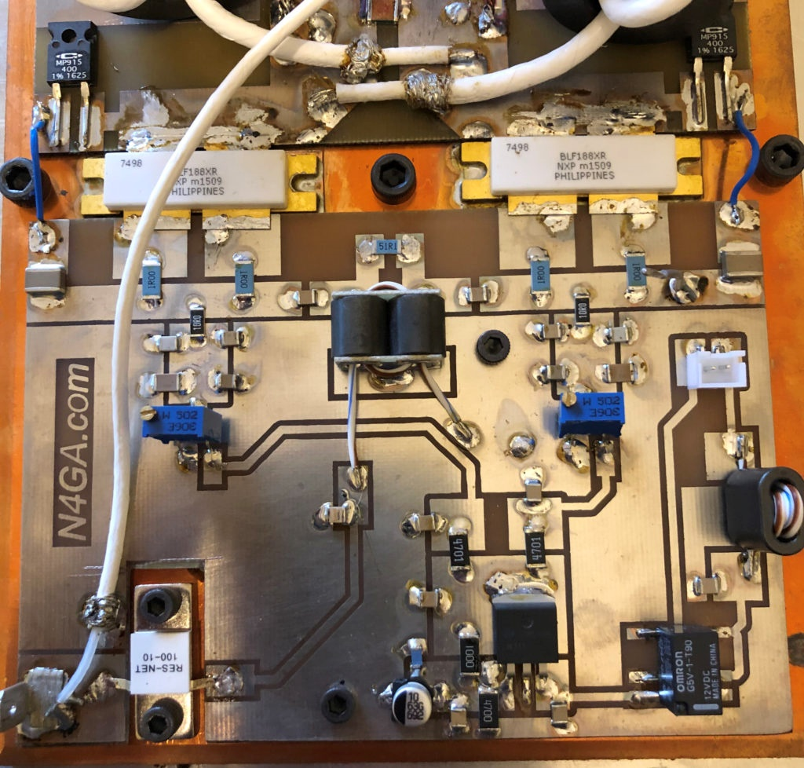
N4GA Bias Board

Slide 40
WA1MBA Filter - not a new idea
Trying a (high power) Constant Impedance Filter – Just like Broadcast Transmitters and the FLEX Power Genius HF PA “Harmonic Load”
Put it on output of PA, between PA and LP Filter
Prevents harmonics and other products reflecting back into amplifier from LP Filter
Reduces unwanted PA mixing products – IMD – just like a constant impedance filter on a mixer IF and RF port reduces IMD

Slide 41
Firsts – the Test Setup
Built a 2 tone generator (audio in to FLEX 6700)
Built a 222 up-converter, 28 MHz in at 0 dBm, output 7 to 15 W sufficient to drive a KW class LDMOS amplifier
Made a diagram, found a bunch of standard amplifiers (mostly Minicircuits), a Mixer, a bunch of filters, included couplers to sample signals
Built some filters
Performed experiments

Slide 42
Observations
Getting signal levels right and adjustable, and making repeatable measurements is a bear
Some low level gain blocks have fairly poor IMD performance, some have excellent
No amplifier produced better than -30dBc IMD (military, not ARRL dB) when driven beyond 6 dB below P1dB compression point.
That means ¼ of the “rated power” - INCLUDING
$600 60 – 300 MHz 10 watt Minicircuits amplifier
Q5 Signal 25 watt 222 amp

Slide 43
Circuit
Transceiver
28 MHz 0 dBm
IMD at least -80 dBc
Mixer IF input
28 MHz -3 dBm
IMD -69 dBc
30 MHz
BPF
ATT
PIF 30
IF
10 MHz Ref
DigiLO
194
MHz
LO
RF
Fixed
Atten
MBA Dual +
DEMI SAW
Fixed
Atten
MCL
ZHL03-5
Q5 25 W
222 Power Amp
MCL 3011
ATT
Mixer RF output
222 MHz variable
-31 to -10 dBm
IMD -60 worst case
Driver RF output
222 MHz variable
+1 to +20 dBm
IMD -55 to -44 dBc
RF Power output
222 MHz variable
+23 to +42 dBm
IMD -49 to -17 dBc

Slide 44
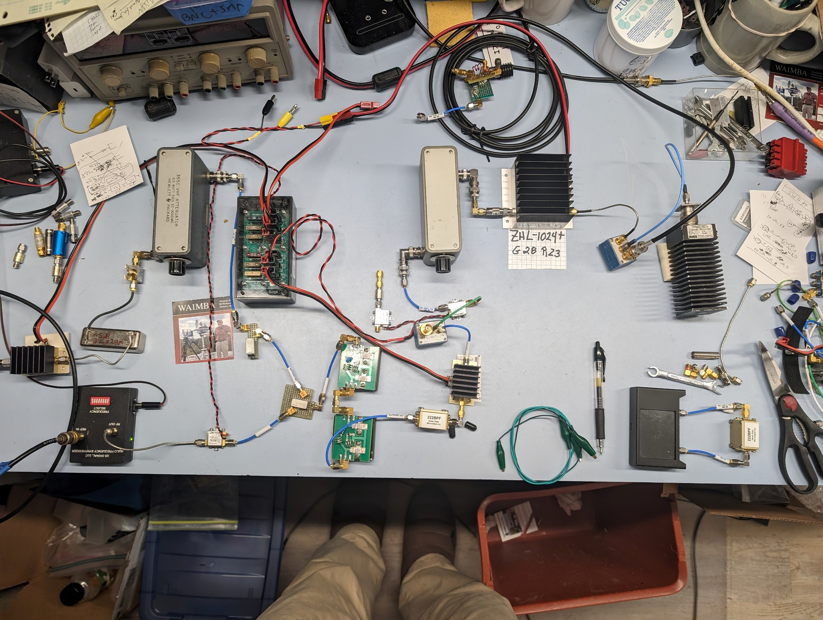

Slide 45
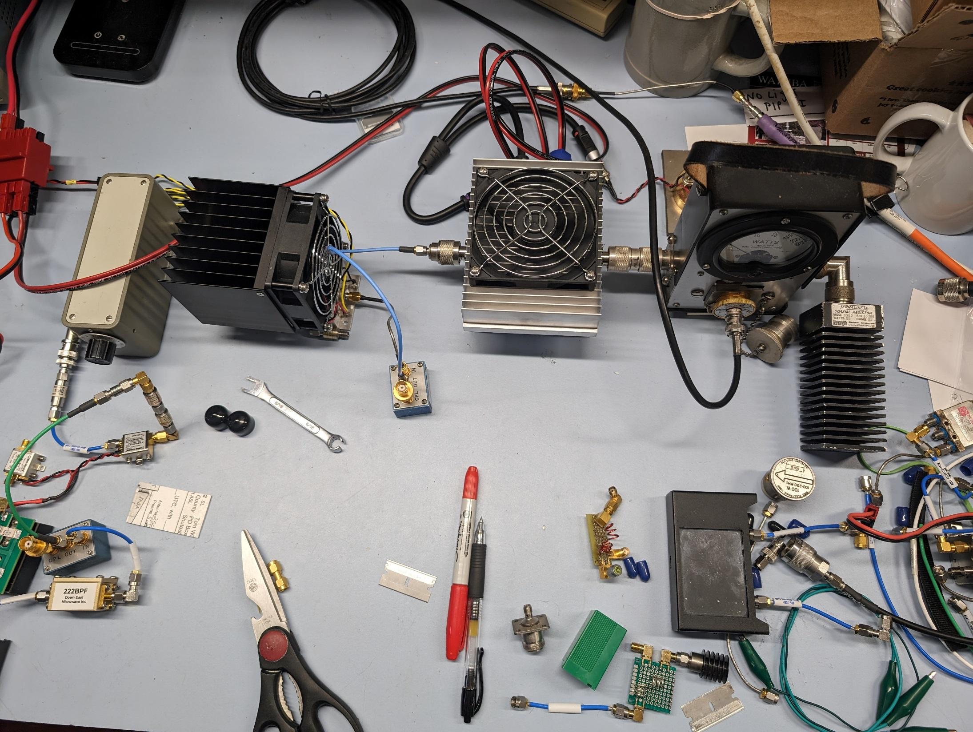

Slide 46
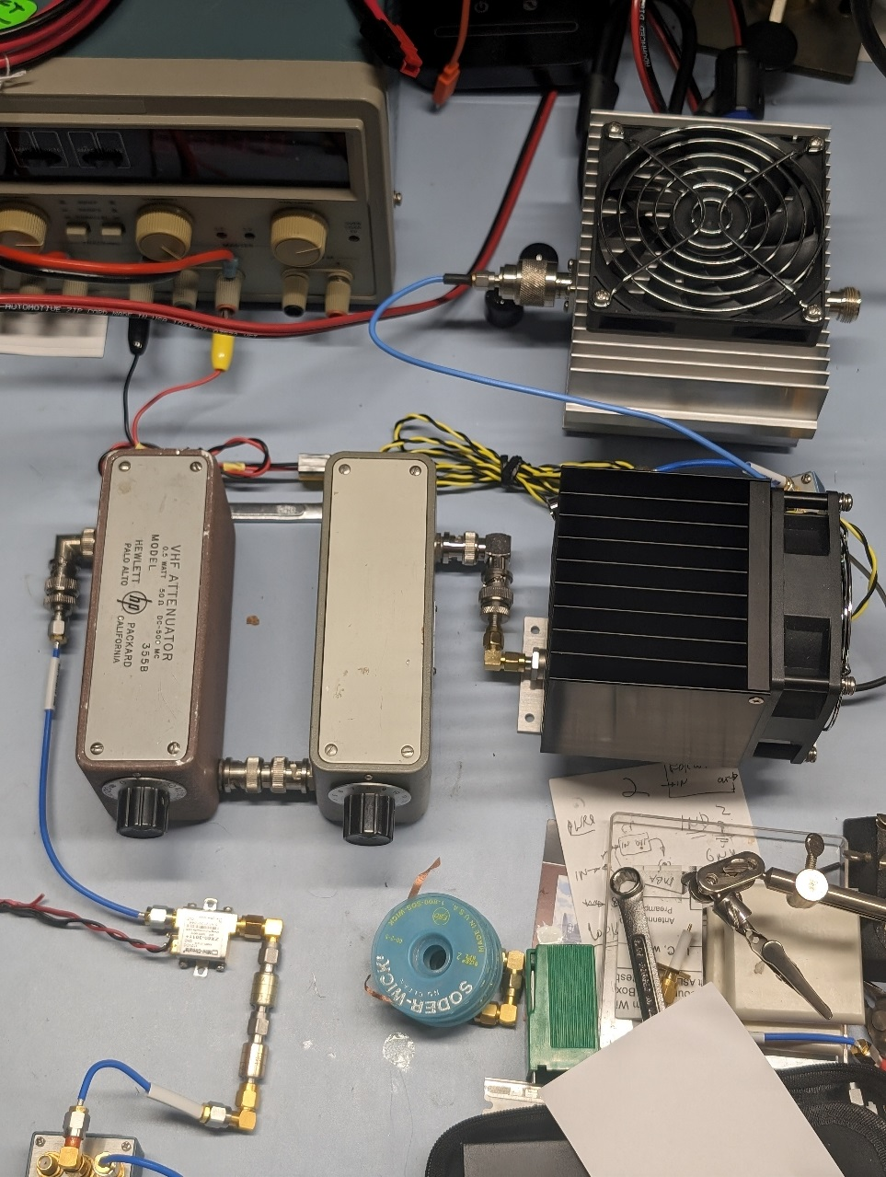

Slide 47
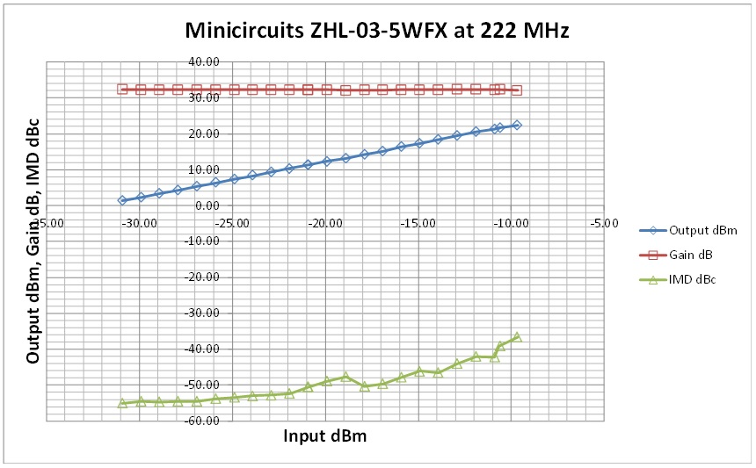
Driver Amp Results

Slide 48
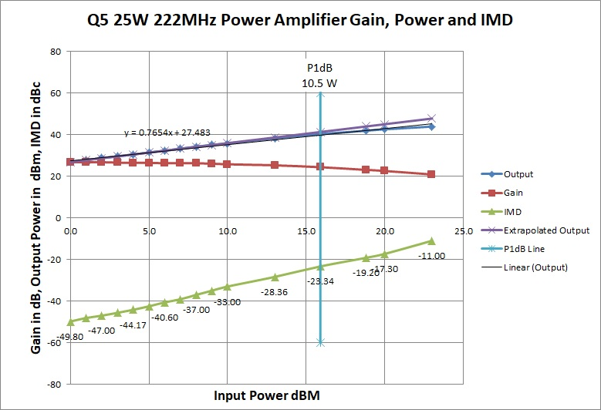
25 W Power Amp Results

Slide 49
Results
It was possible for me to build an upconverter that produced 7 watts at -35dBc IMD*
Filtered the Mixer IF port using a Minicircuits PIF-30 constant impedance filter
Filtered the Mixer RF port using two home brew constant impedance filters followed by a DEMI 222 BPF (SAW filter)
Adjusted signal levels throughout system so that could vary final power up to full 25 watts while maintaining drive to that final amplifier at -40 dBc IMD*

Slide 50
Results
Working on 222 power amp – didn’t finish construction in time for conference
Just finished first version of diplexer, of course, it needs to be designed better, then tuned
Hope to complete next steps before CSVHF
However, did add a “line stretcher” to output of 25 W amp into LPF and load, and could affect IMD at 10 watts by nearly 3 dB by changing phase of reflected harmonics

Slide 51
Recommendations
If you are designing any circuit which is going to be transmitting SSB or AM (and therefore want to limit unnecessary IMD)
Try to make it as linear as you can
If you are not able accurately measure IMD, keep the output level 7 dB below the P1dB point
Try to terminate all ports properly (50 Ohms) at all frequencies from the lowest to at least 3 times that

Slide 52
And, there is plenty of Receive IMD
Overdriven LNAs
Overdriven transverter amplifiers
Overdriven Mixers
Improperly terminated amplifiers and mixers
Unless you know your signal limits when IMD starts, don’t blame your local station for transmitting it
To test, turn your antenna and watch the unwanted components on your spectrum scope and waterfall
If the relative heights between unwanted (out of normal bandwidth) products and peaks stay the same, it is the transmitter.
If they change its at least partly your receiver

Slide 53
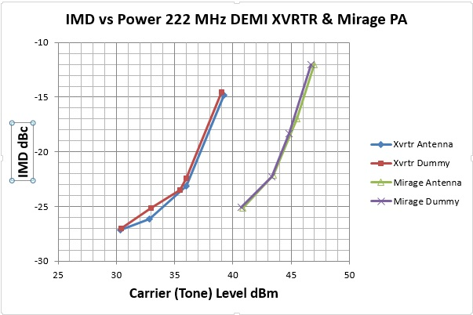
Don’t be like Me -12 dBc = Mr Splatter Fortunately, I often use CW & Crank it up to 100 W

Slide 54
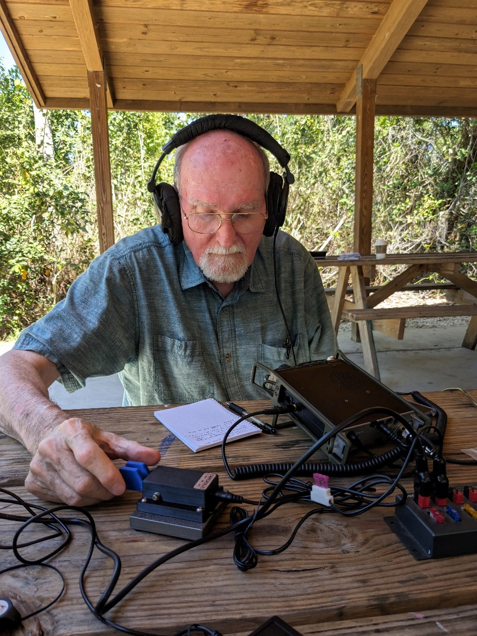
FYI - I do POTA sometimes, and like CW

Slide 55
Let’s sequence, I’ll TX on Even

