Slide 1
Very Low Noise Unconditionally Stable MMIC Amplifiers
Paul Wade W1GHZ

Slide 2
Remember Building Preamps?
Exotic Device - $$$
Johanson Trimmers
Finicky construction
Tune until trimmers wear out
NF changes on antenna
Oscillates if bird flies by
➔ 3 dB NF

Slide 3
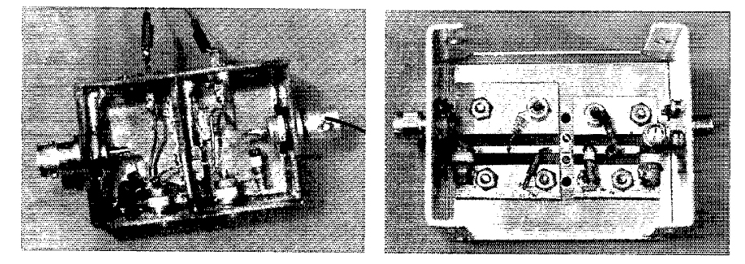
QST 1978 GaAsFET

Slide 4
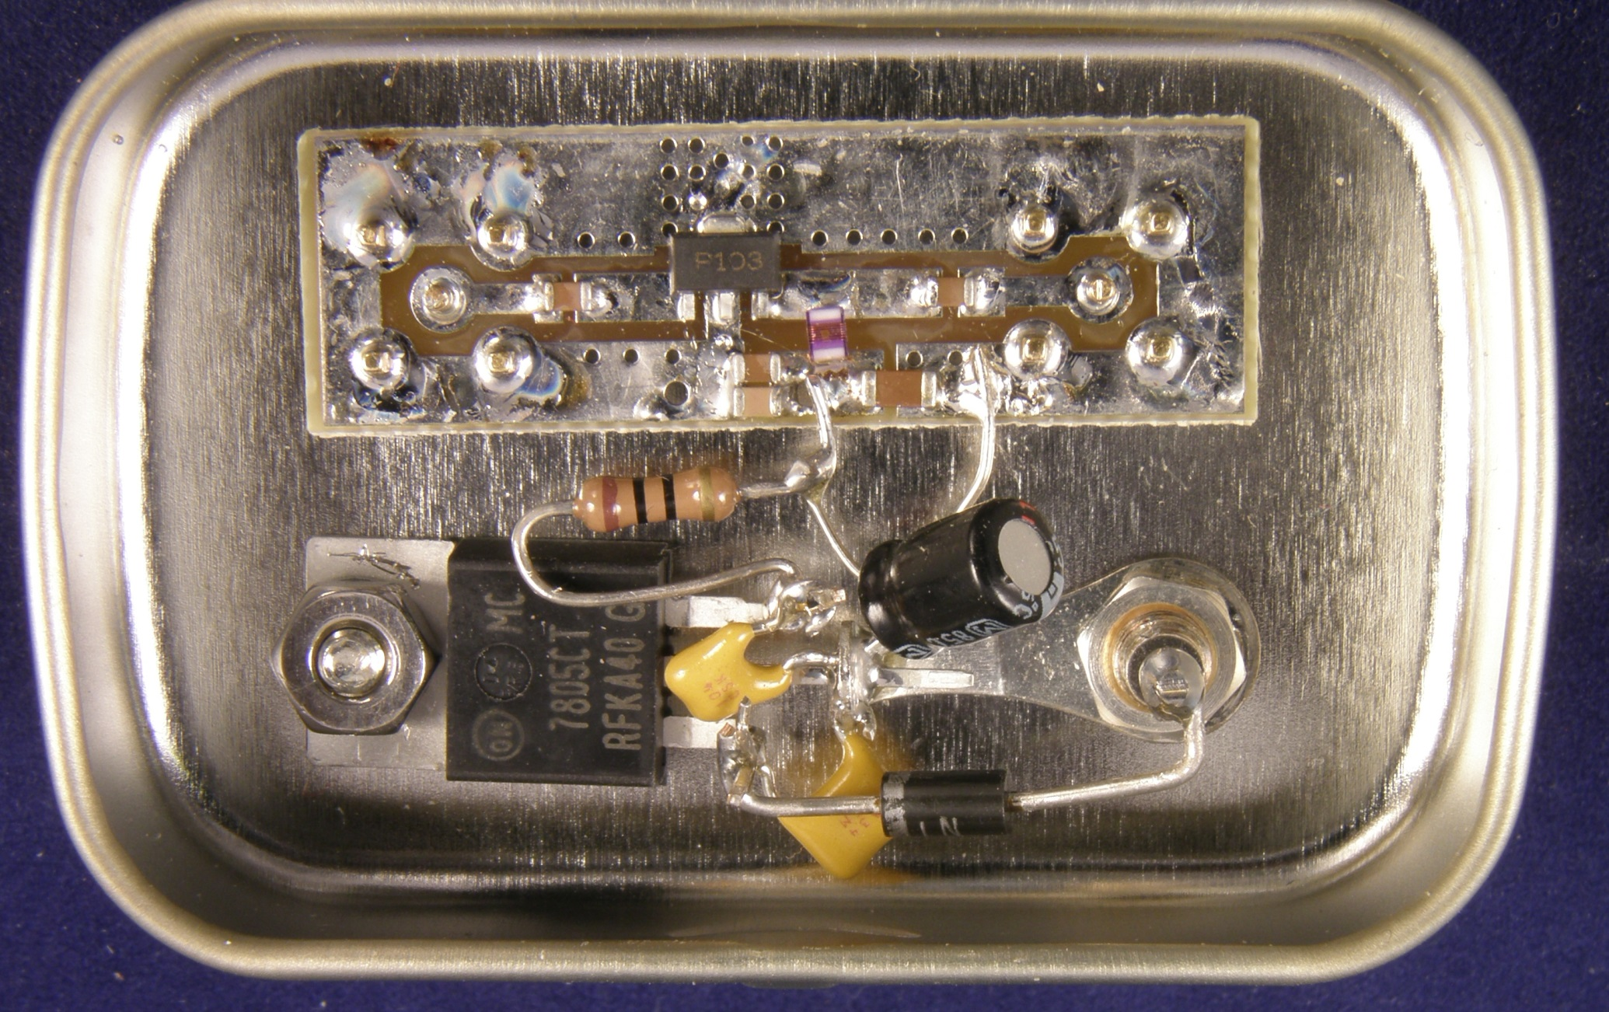
2016 MMIC – PGA-103

Slide 5
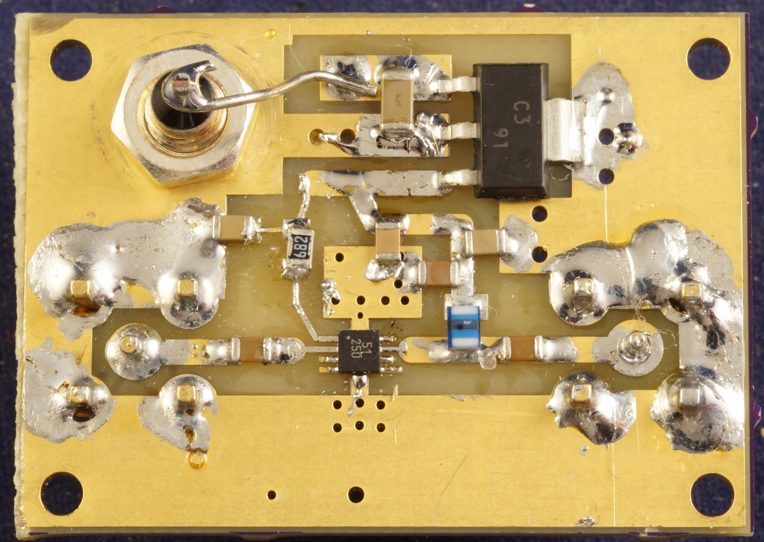
2024 MMIC – NXP BGU8051 Uncondiotionally Stable

Slide 6
NXP BGU8051 MMIC
Tiny Package – 2 mm square
No leads – pads under package
Ground pad under middle
Pad spacing 0.5 mm
Bias resistor to set current
Toaster 0ven soldering – N1JEZ

Slide 7
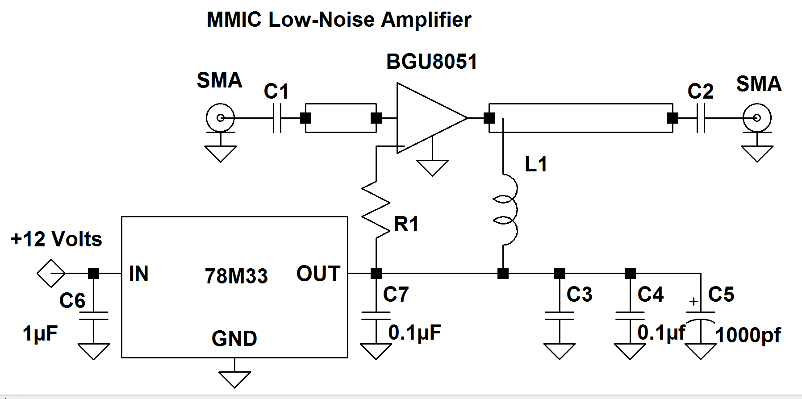
Simple Schematic

Slide 8
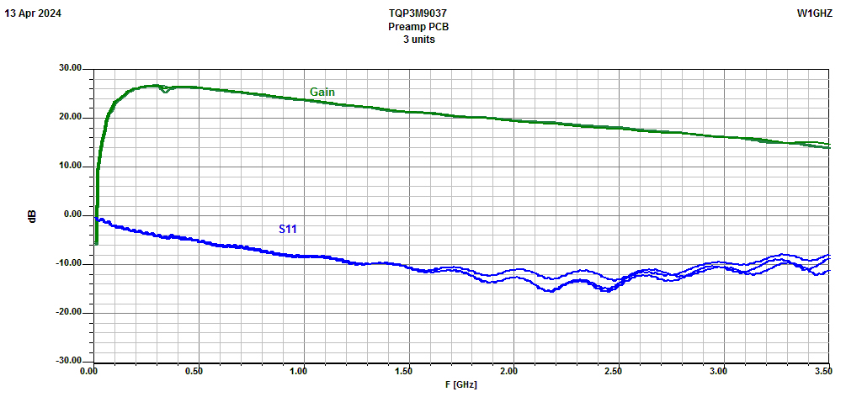
BGU8051 Performance

Slide 9
Unconditionally Stability
Will not oscillate
Performance less sensitive to impedances
Rollet’s Stability Factor:

Slide 10
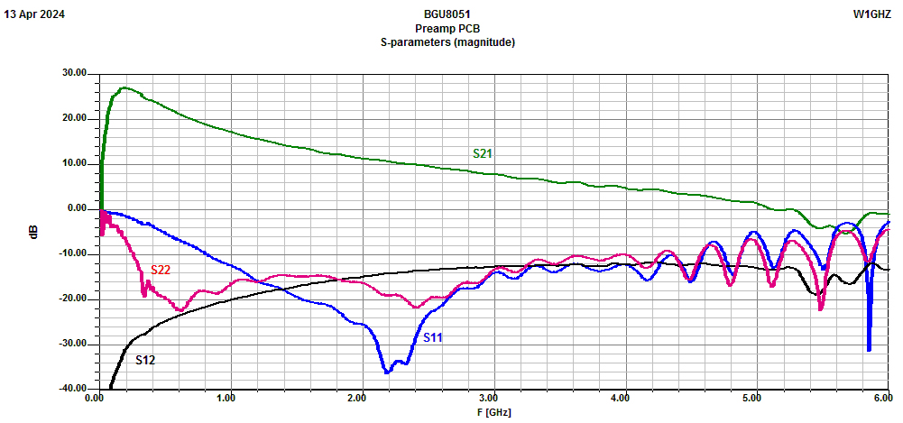
Simple Stability Gain (S21) less than Isolation (S12)

Slide 11
BGU8051 Noise Figure
Poor calibration at very low NF
Approximate NF based on comparison to previously measured units
144 MHz: ~ 0.25 to 0.4 dB
432 MHz: ~ 0.4 dB
1296 MHz: ~ 0.5 dB $±$
Better measurement at conference

Slide 12
Similar MMICs
Qorvo QPL9547 – needs bias resistor
Qorvo TQP3M9036 – no resistor
Qorvo TQP3M9037 – no resistor
All fit same preamp PCB
All Unconditionally Stable

Slide 13
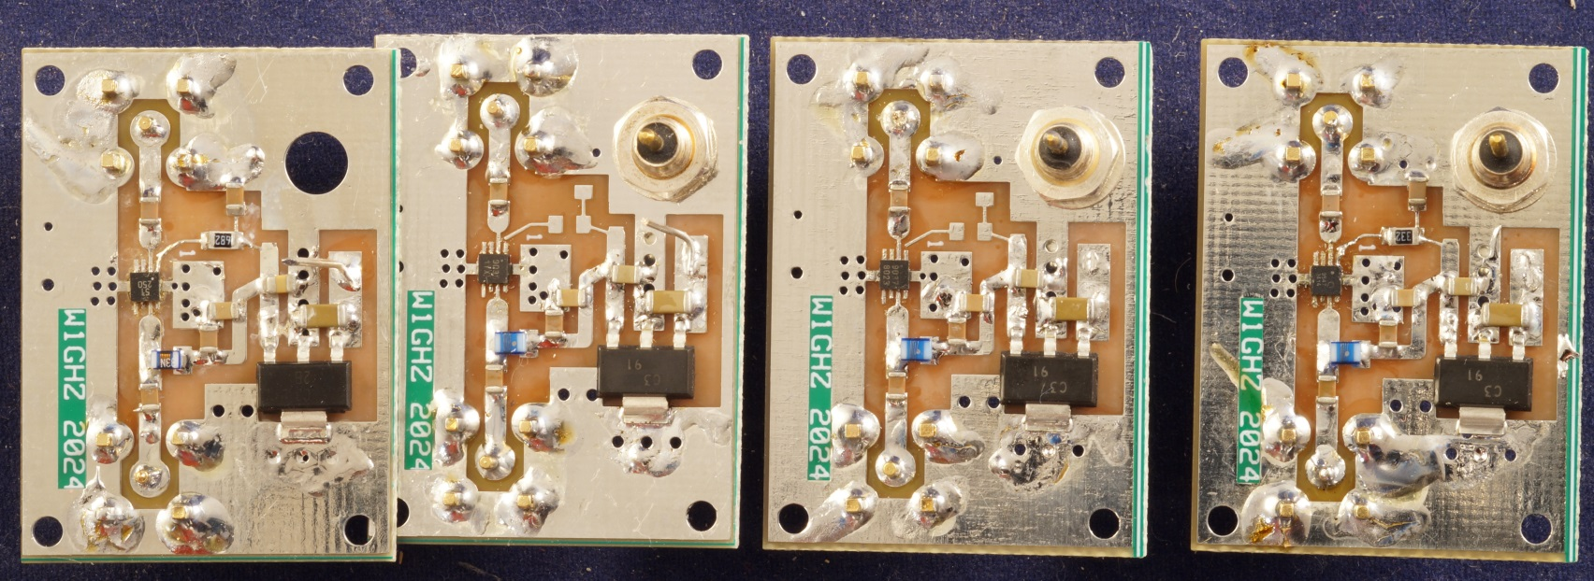
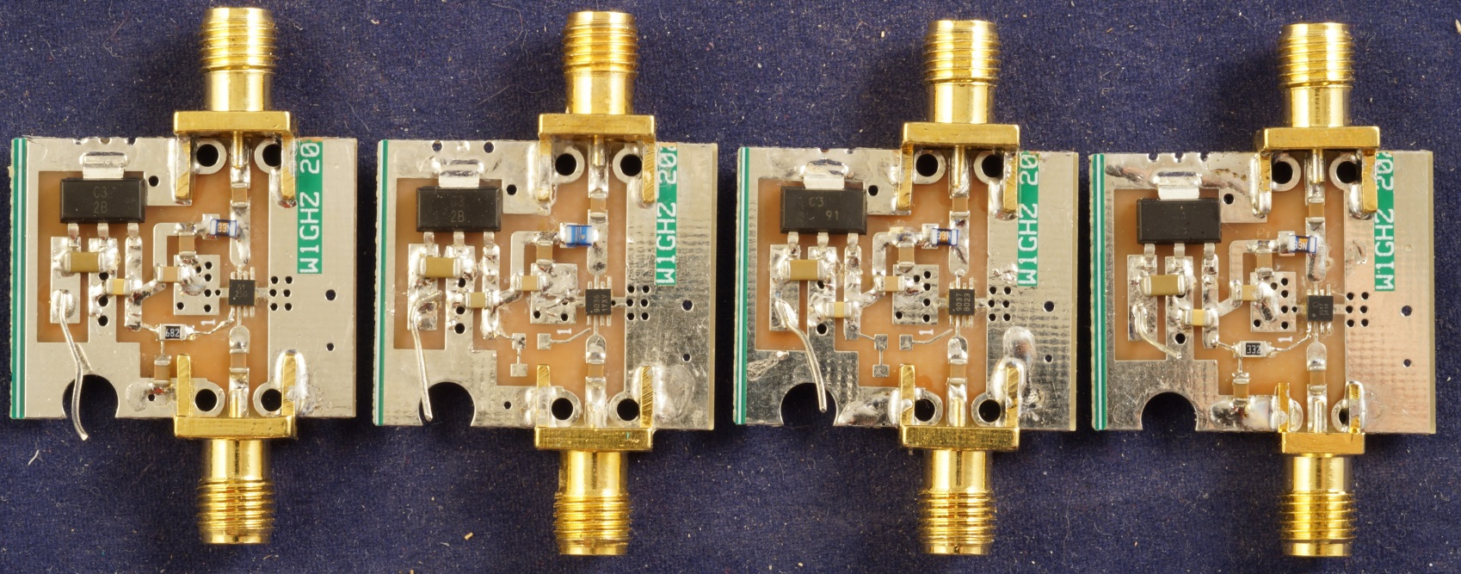
Comparison of 4 MMIC types

Slide 14
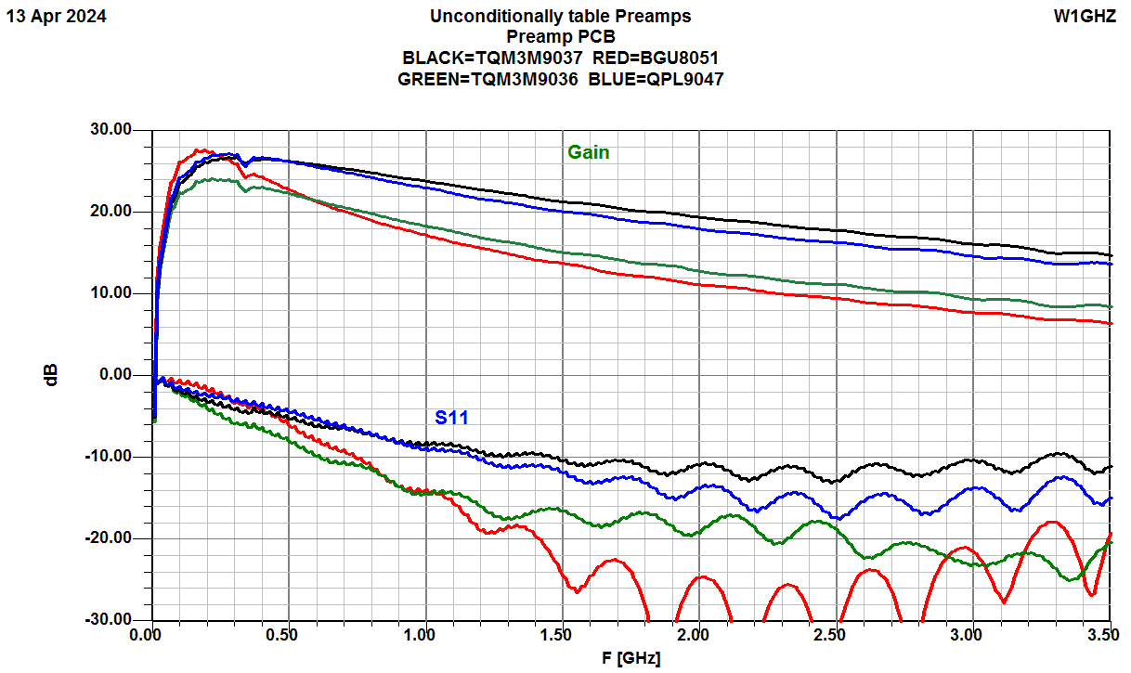
Comparison of 4 MMIC types

Slide 15
Comparison of 4 MMIC types
All have comparable Noise Figure up to 1296
QPL9547 and TQP3M9037 better gain to 3.4 G
This PC board not good at 5760

Slide 16
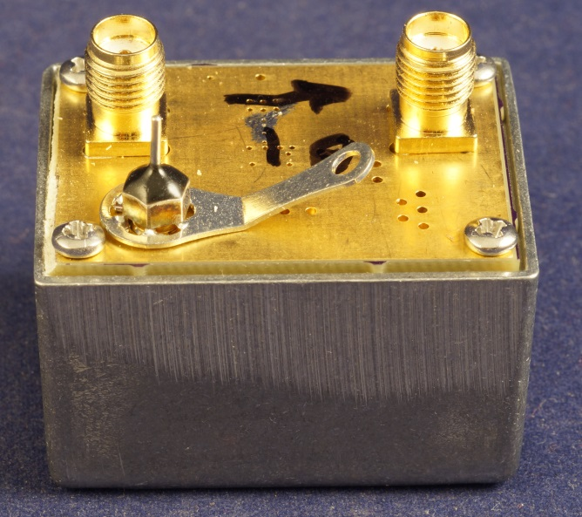
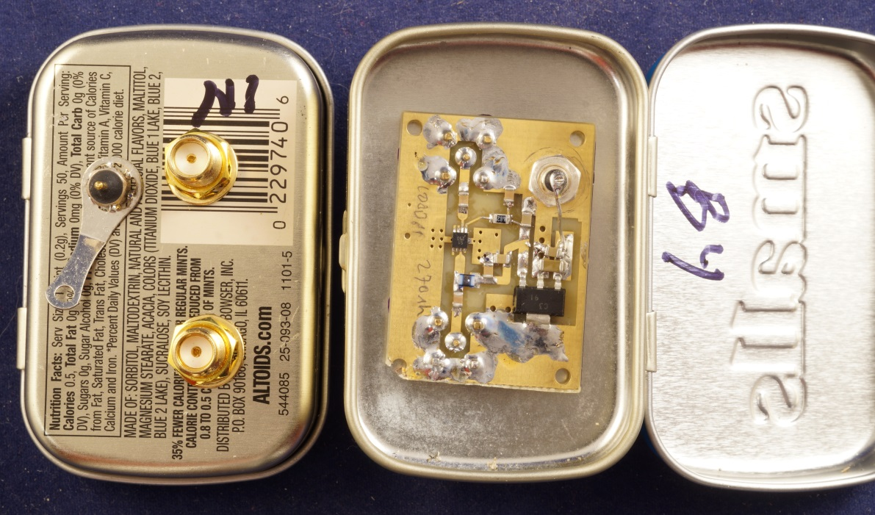
Package
PC board fits in smallest Pomona box
Fits fine in small Altoids tin

Slide 17
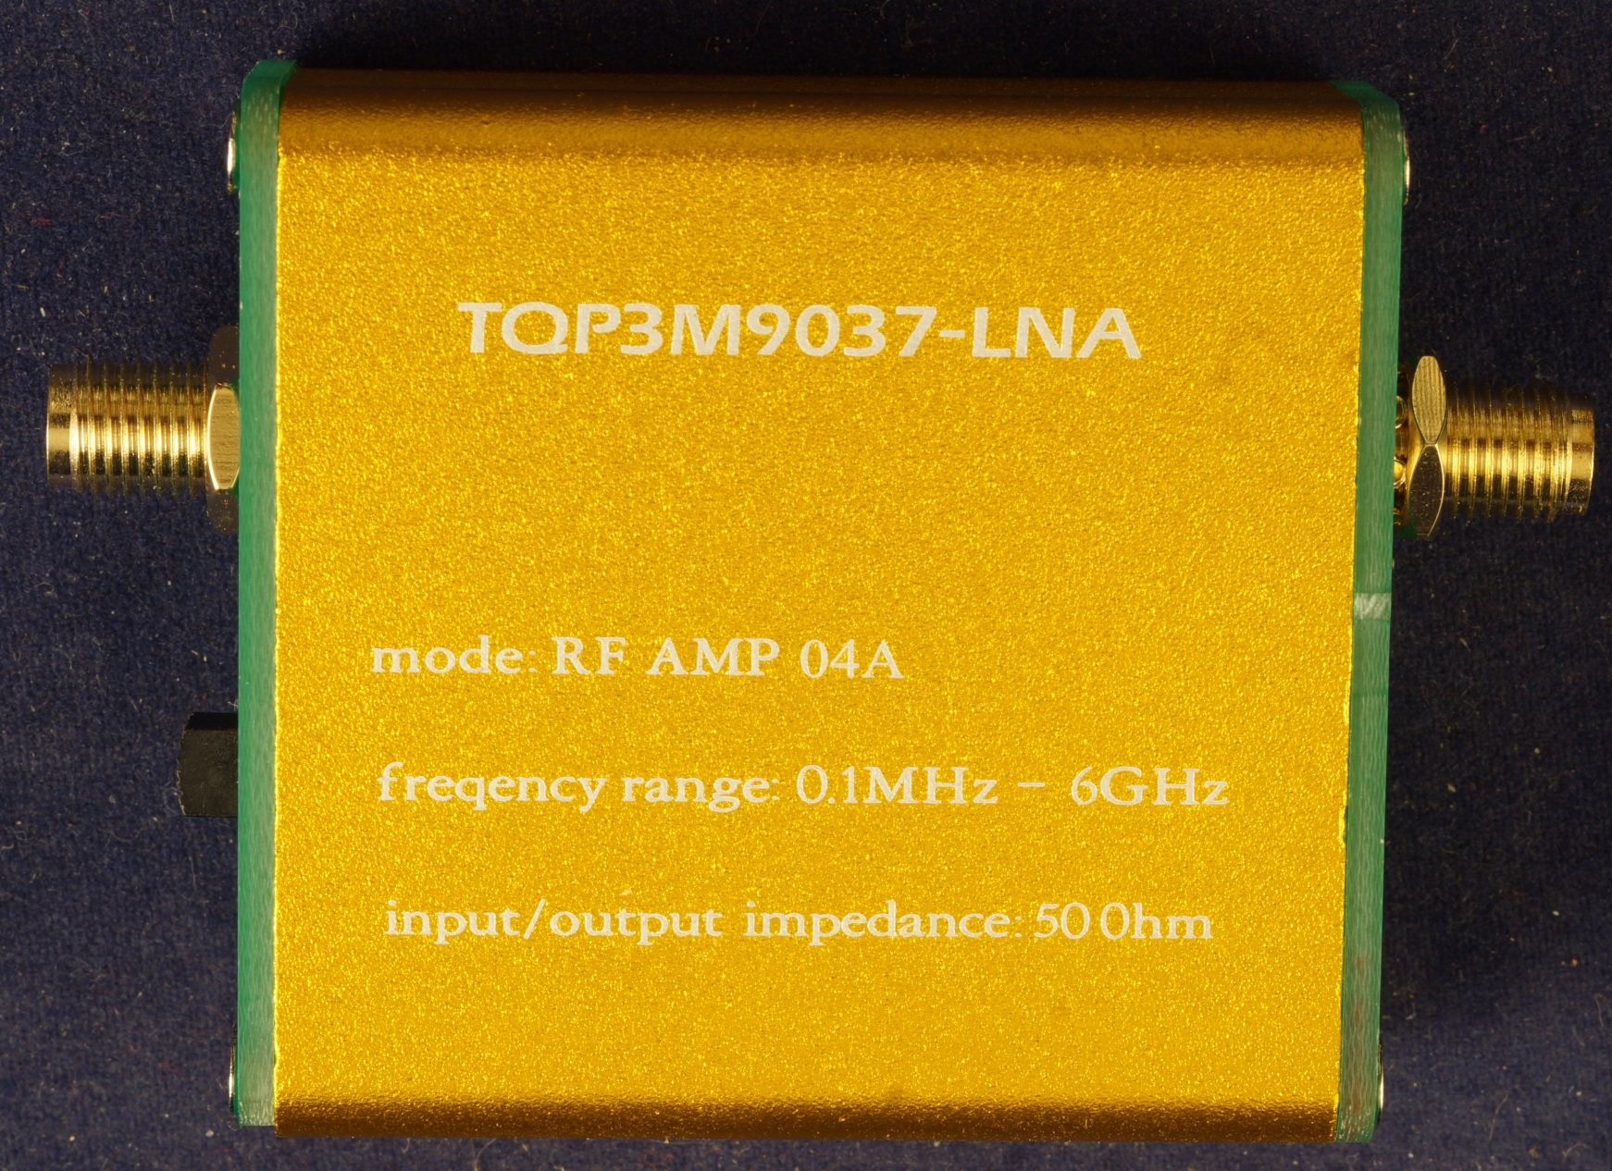
ebay module - TQP3M9037 LNA

Slide 18
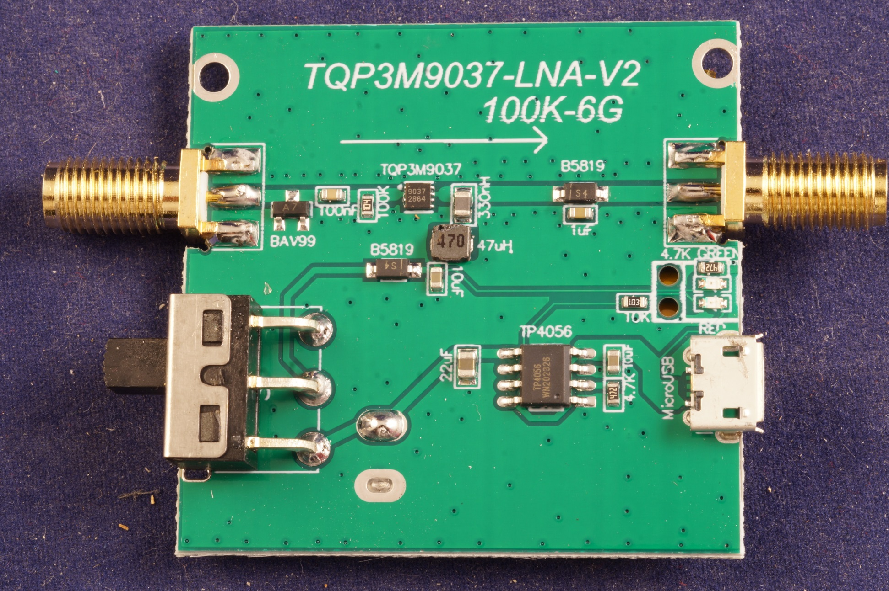
ebay module - TQP3M9037 LNA

Slide 19
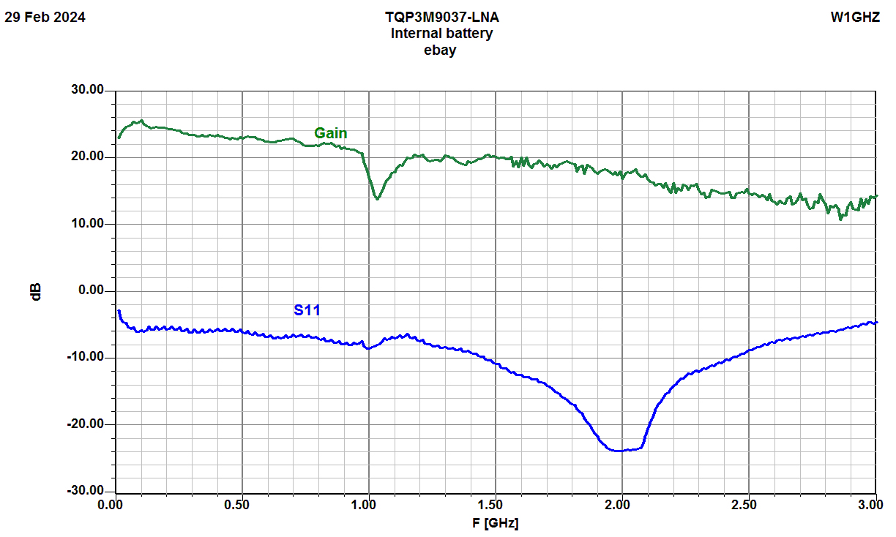
ebay module - TQP3M9037 LNA

Slide 20
MMIC Preamps
Very low Noise Figure
Simple
Unconditionally stable
No tuning (you can try for better NF)
MMICs from Mouser - $3 to $5
PC boards available if there is interest
Toaster Oven soldering

Slide 21
No tuning
No tune preamp
No tune SSPA
No tune transverter
Fixed calling frequency
Who needs a tuning tool?

Slide 22
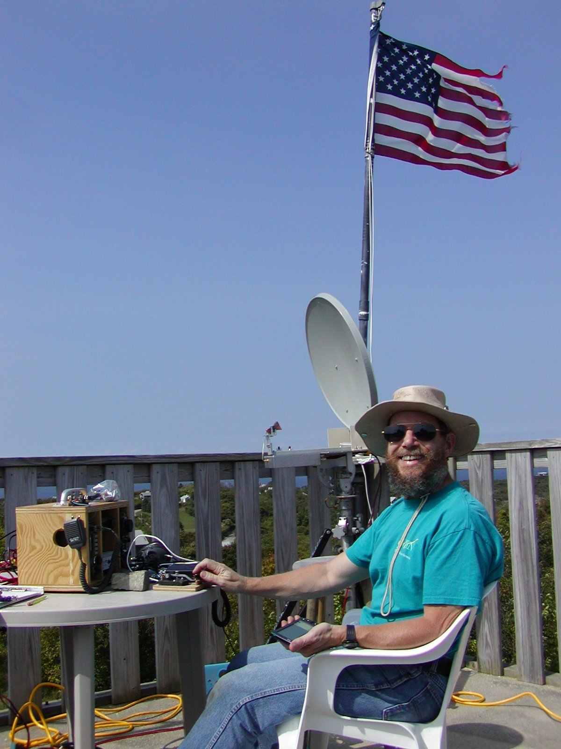
www.w1ghz.org

