Slide 1
10 MHz Reference with GPS Switch Automatically switches from OCXO to GPS
Paul Wade W1GHZ

Slide 2
Rover Dilemma
Be ready to go – near frequency
OR
Wait for GPS – accurate frequency
Better for DX

Slide 3
W1GHZ 2023
OCXO
GPS
DEMI 10-4 Splitter to 10, 24, & 47 GHz
3 boxes, move cables when GPS locks

Slide 4
2024
WA1ZMS found some nice 10 MHz OCXO in dumpster
Integrate with automatic switching
Detect 10 MHz from GPS
Switch RF to GPS
Turn off OCXO
Learn KiCAD program for PCB design
Error checking
FREE – share files

Slide 6
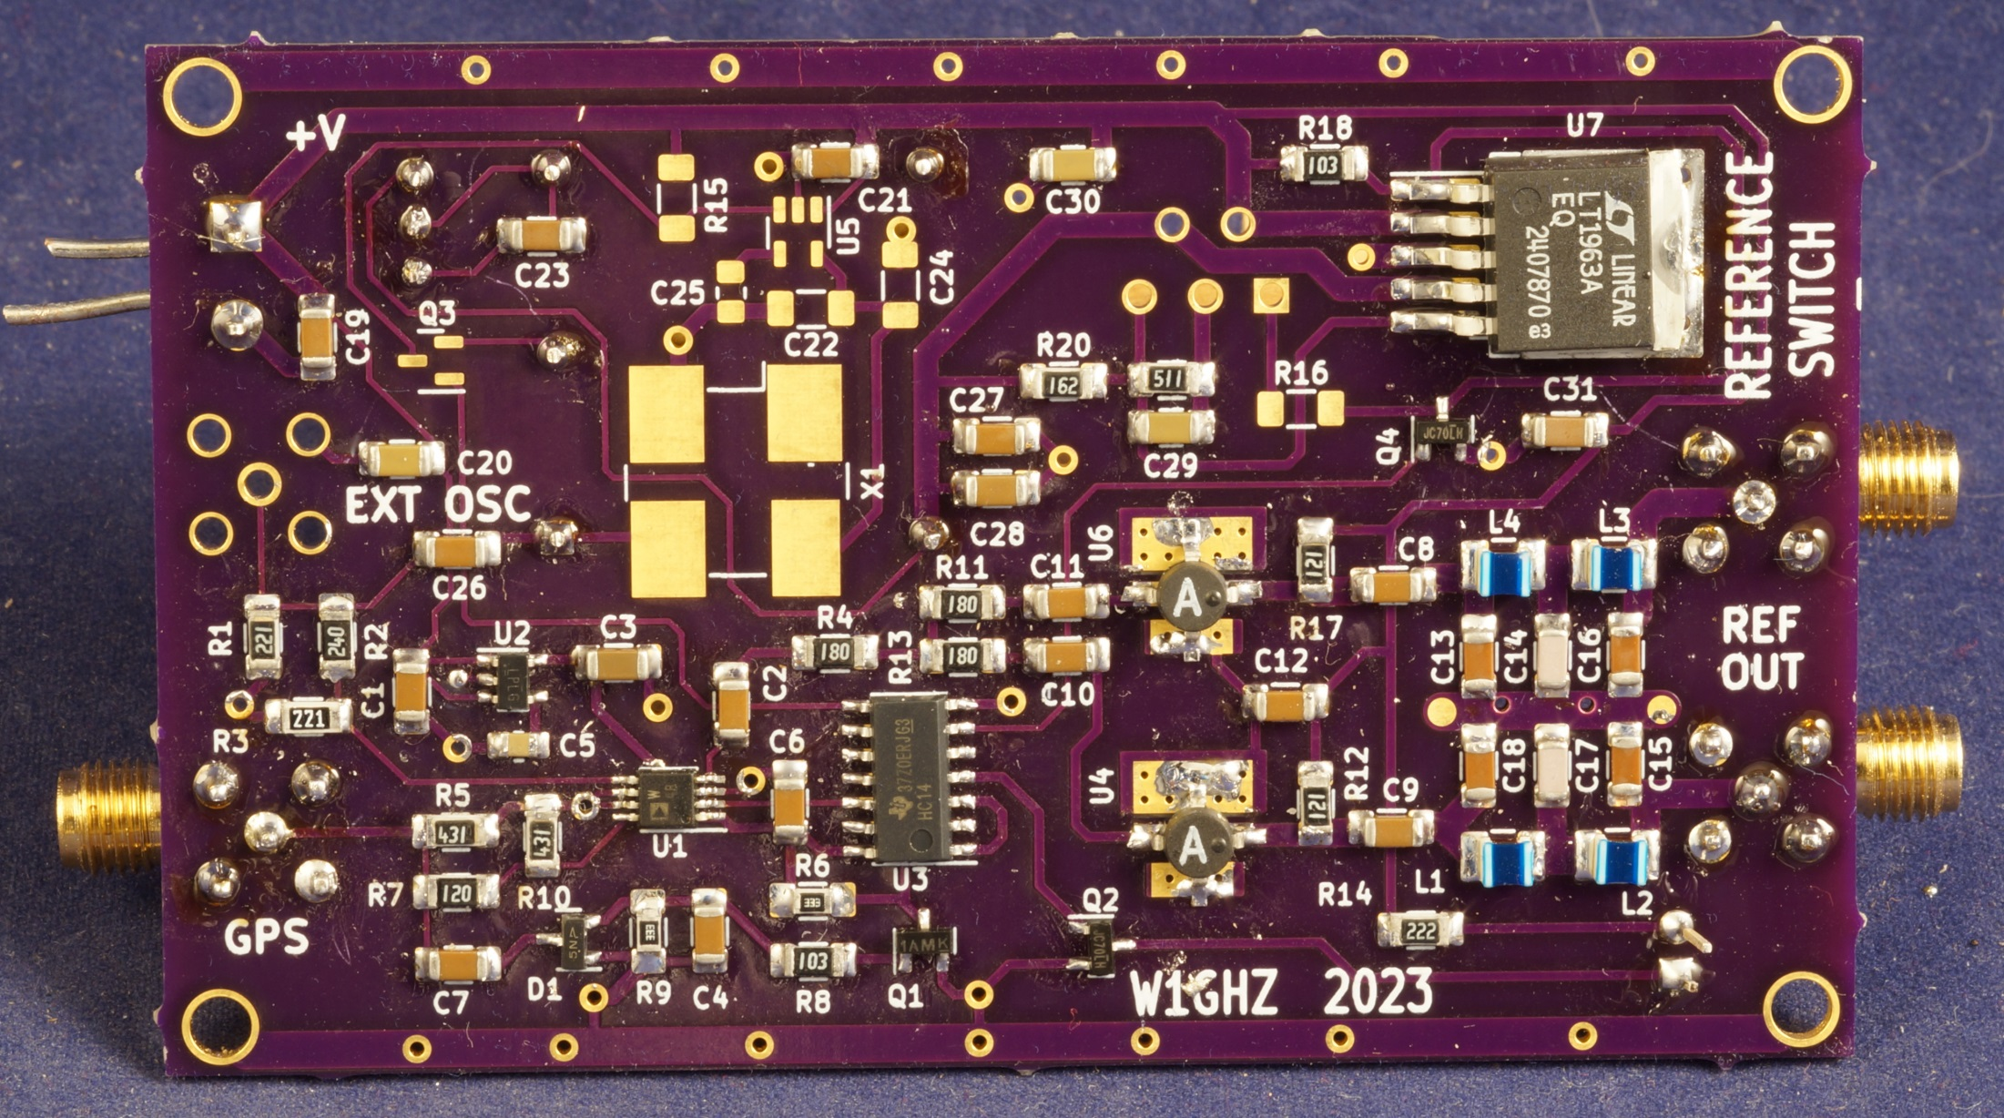
10 MHz Reference with GPS Switch

Slide 7
Schematic

Slide 8
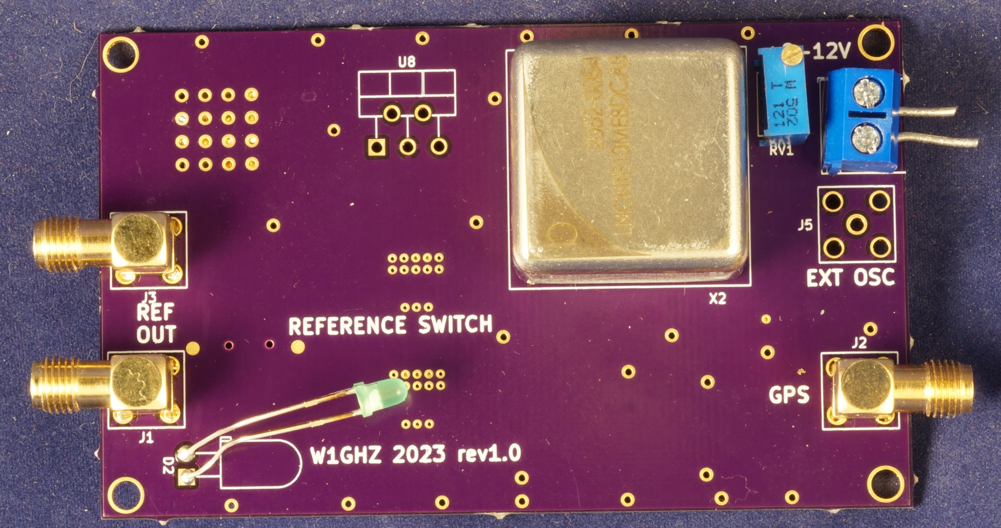
Far Side

Slide 9
Features
Switches at +7 dBm from GPS
Two 10 MHz outputs with LPF – sine wave
OCXO Frequency trim
Attenuators to match output levels
Pads for cheap oscillator or external OCXO
BUT
Limited supply of OCXO – others won’t fit
OCXO draws serious power – ½ amp at start

Slide 10
Lower Power Version with more available oscillator
10 MHz oscillator from DEMI
Stable within $±2 Hz$ for a week
New PCB

Slide 11
Low Power Reference & Switch
Nothing on far side of PCB

Slide 12
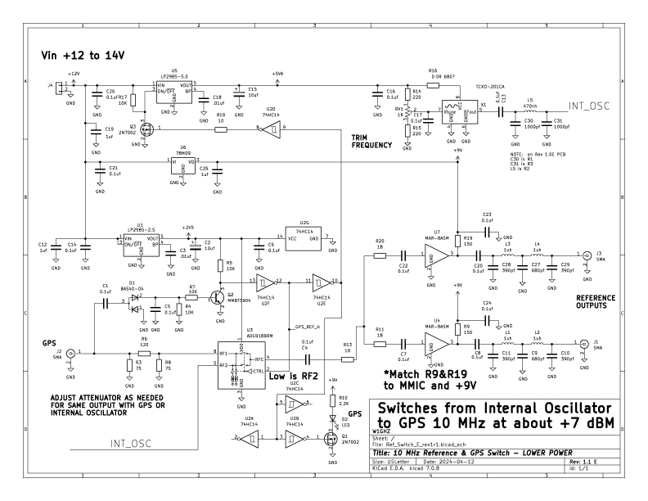
Schematic

Slide 13
Low Power version Featues
Switches at +7 dBm from GPS
Two 10 MHz outputs with LPF – sine wave
Oscillator Frequency trim
Attenuators to match output levels
~ 100 ma total – leave on
Small parts but hand solderable
or Toaster Oven
PC boards and oscillators available

Slide 14
Summary
10 MHz Reference ready to go
Switches when GPS ready
PC boards and oscillator for Low Power version available
Other parts from Mouser
PCB KiCAD files available to customize

Slide 15
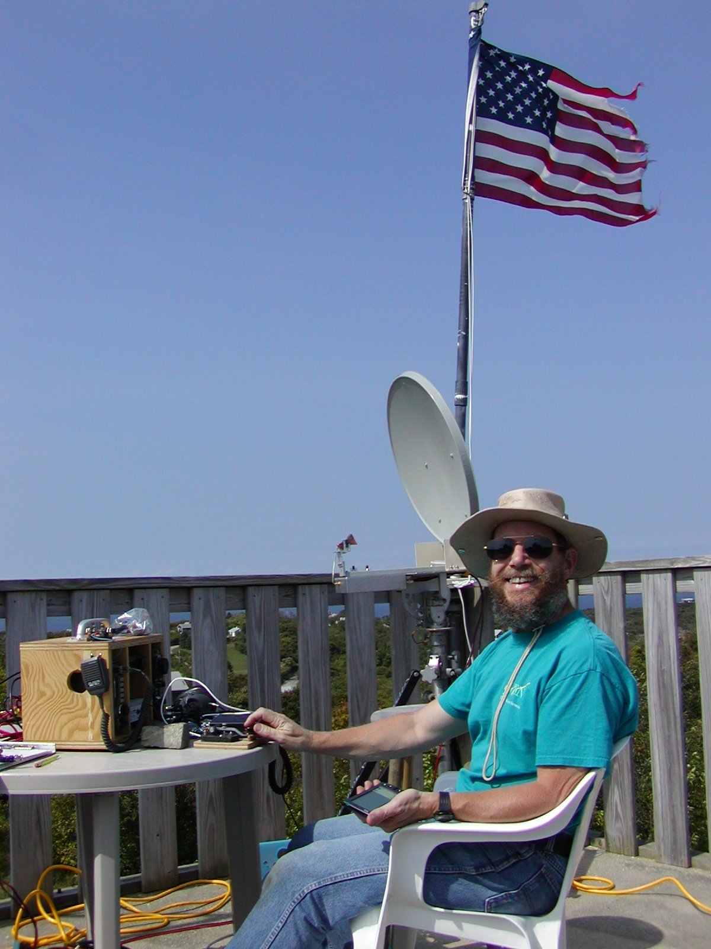
www.w1ghz.org

