Slide 1
Plug in your RTL and Google Zadig

Slide 2
The Zadig home page

Slide 3
Download and open Zadig

Slide 4
Select Bulk-in (interface 0) Click on install driver

Slide 5
Click on Close

Slide 6
Select Bulk-in (interface 1) Click on install driver

Slide 7
Click on Colose

Slide 8
Open SDR Console click on Definitions

Slide 9
In Select Radio pop-up click on Definitions

Slide 10
Click on Search

Slide 11
From the dropdown click on RTL Dongle USB

Slide 12
Click on Add

Slide 13
To rename your RTL click on Edit

Slide 14
Rename your RTL Dongal

Slide 15
Highlight your RTL and choose your Bandwidth. I suggest 1.5MHz

Slide 16
Highlight your RTL and Click on Start

Slide 17
Your RTL settings are on the SDR Console Home tab.

Slide 18
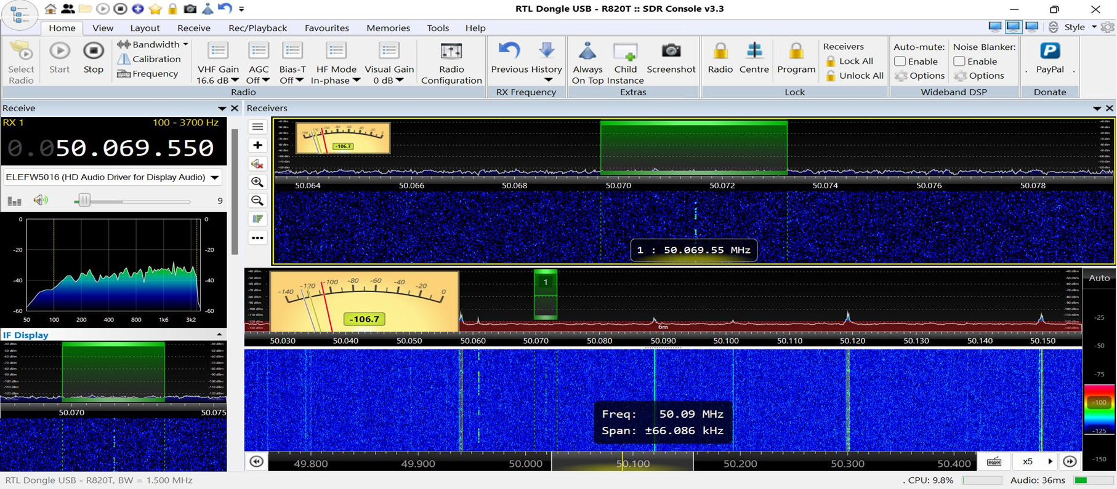
SDR Console with 1 RX

