Slide 1
Sectoral Horns for Microwave Beacons
Paul Wade W1GHZ ©2023

Slide 2
Microwave Beacon Antennas
Traditionally Omnidirectional
Waveguide Slot Antenna
Narrow bandwidth
Difficult to make above 10 GHz
Many sites have unpopulated directions – Why transmit in those directions

Slide 3
10 GHz Beacon – Mt Washington
Beacon down – building was removed
New location on Mt Washington unlikely
Eric, KV1J, has offered to host at FN44rc

Slide 4
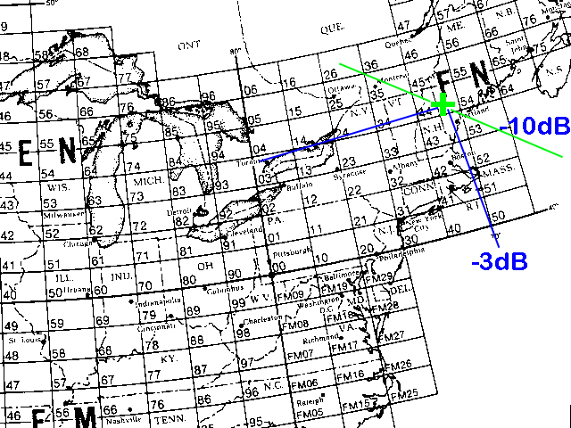
Almost all stations in 90° segment

Slide 5
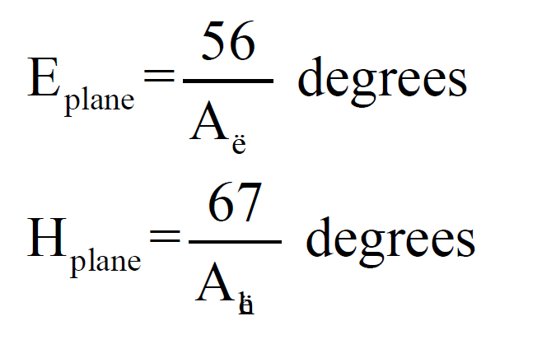
Horn Antenna Beamwidth
Large Aperture gives Narrow Beam
Small Aperture gives Wide Beam

Slide 6
Sectoral Horn
E-plane – small aperture = wide azimuth beam
~ 0.6λ aperture = 90° wide beam (-3dB)
H-plane – large aperture = narrow vertical beam
Higher gain
Horn length > aperture for full gain

Slide 7
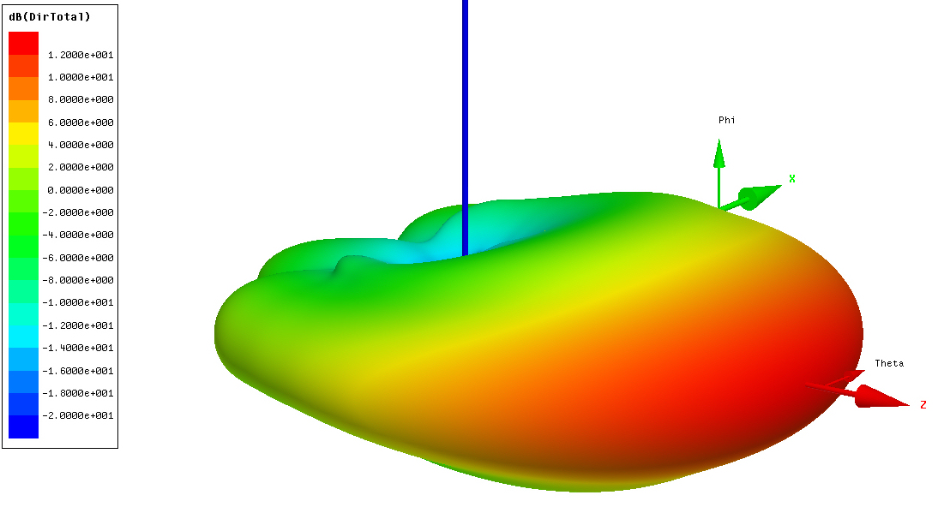
10 GHz Sectoral Horn E = 0.55λ H = 3.3λ

Slide 8
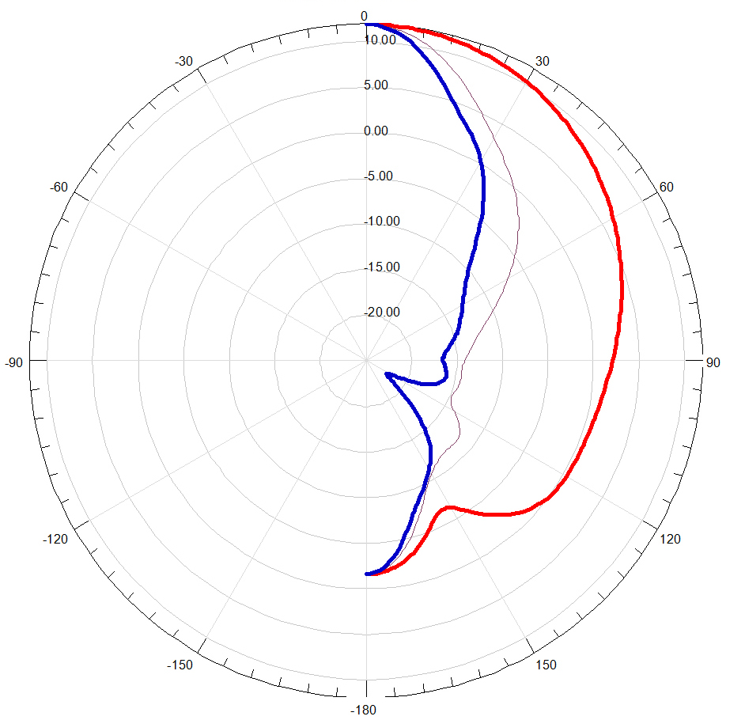
10 GHz Sectoral Horn E = 0.55λ H = 3.3λ

Slide 9
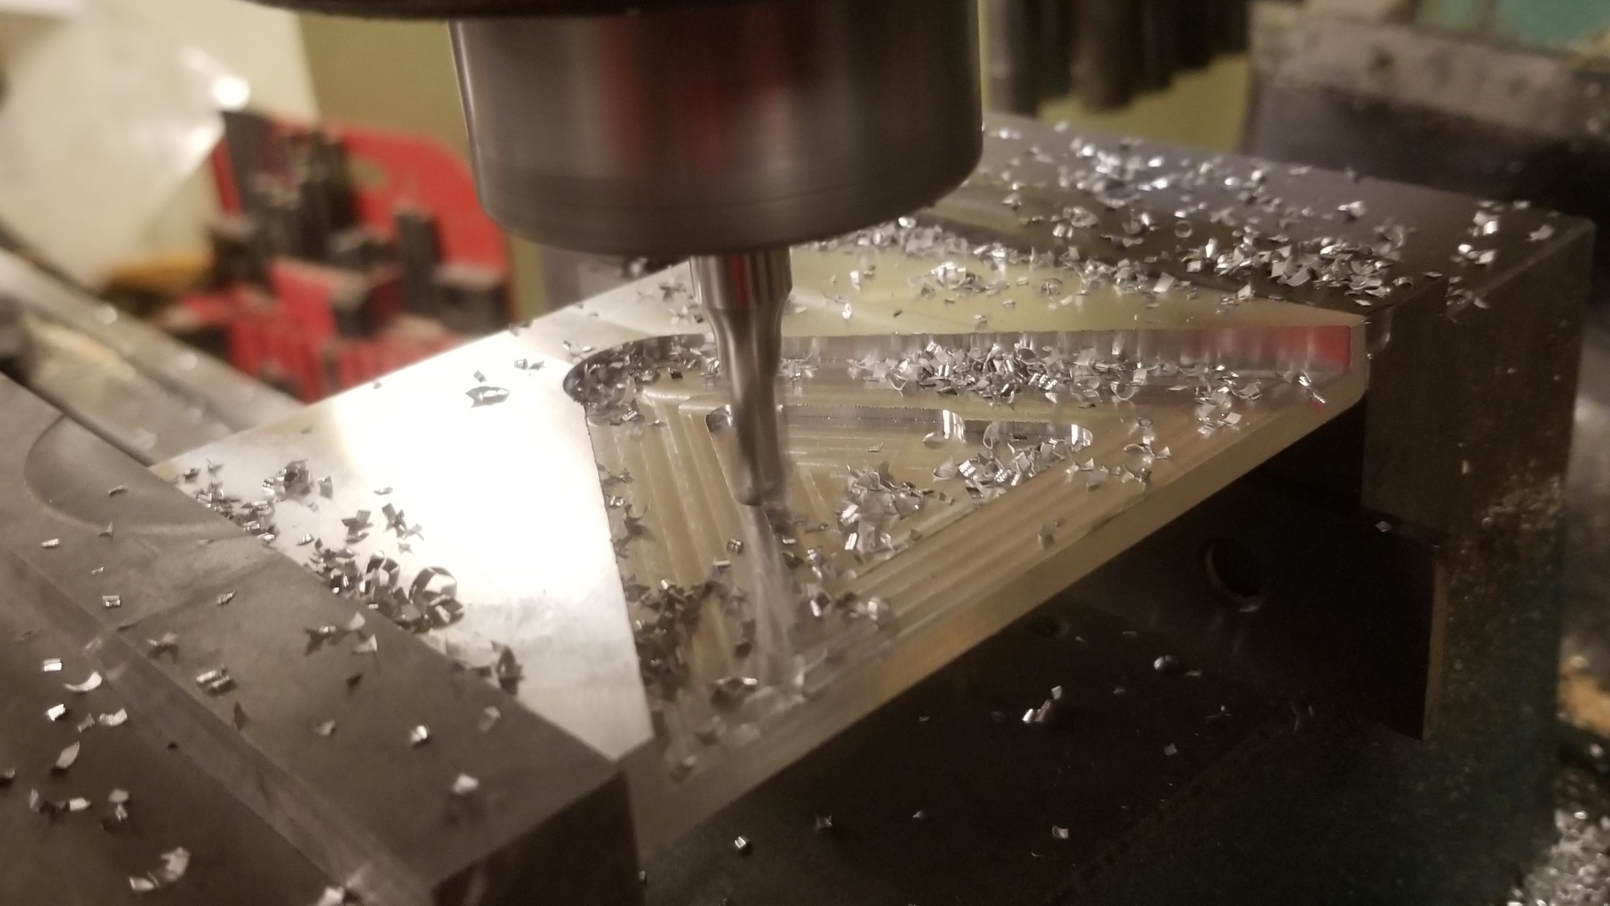
Horn tapered in both axis

Slide 10
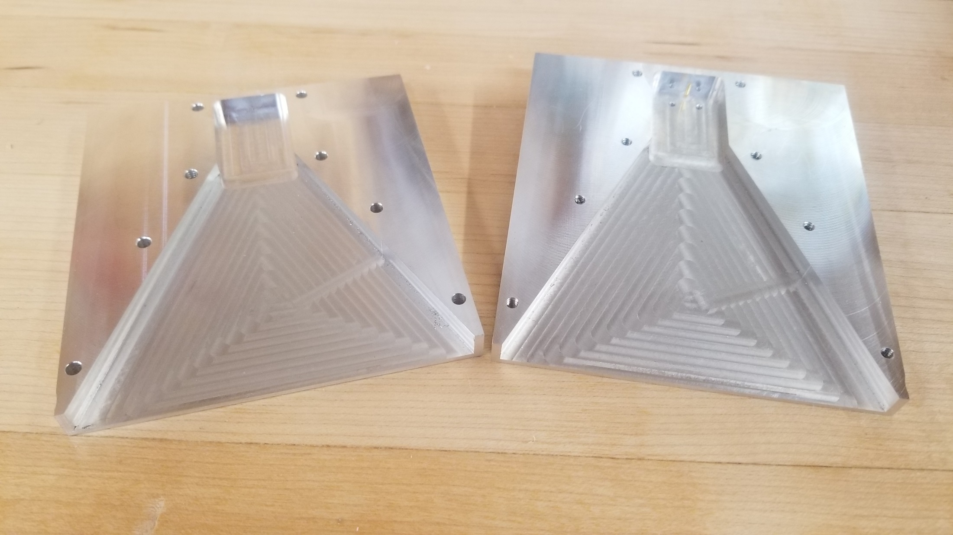
Machine in two tapered halves

Slide 11
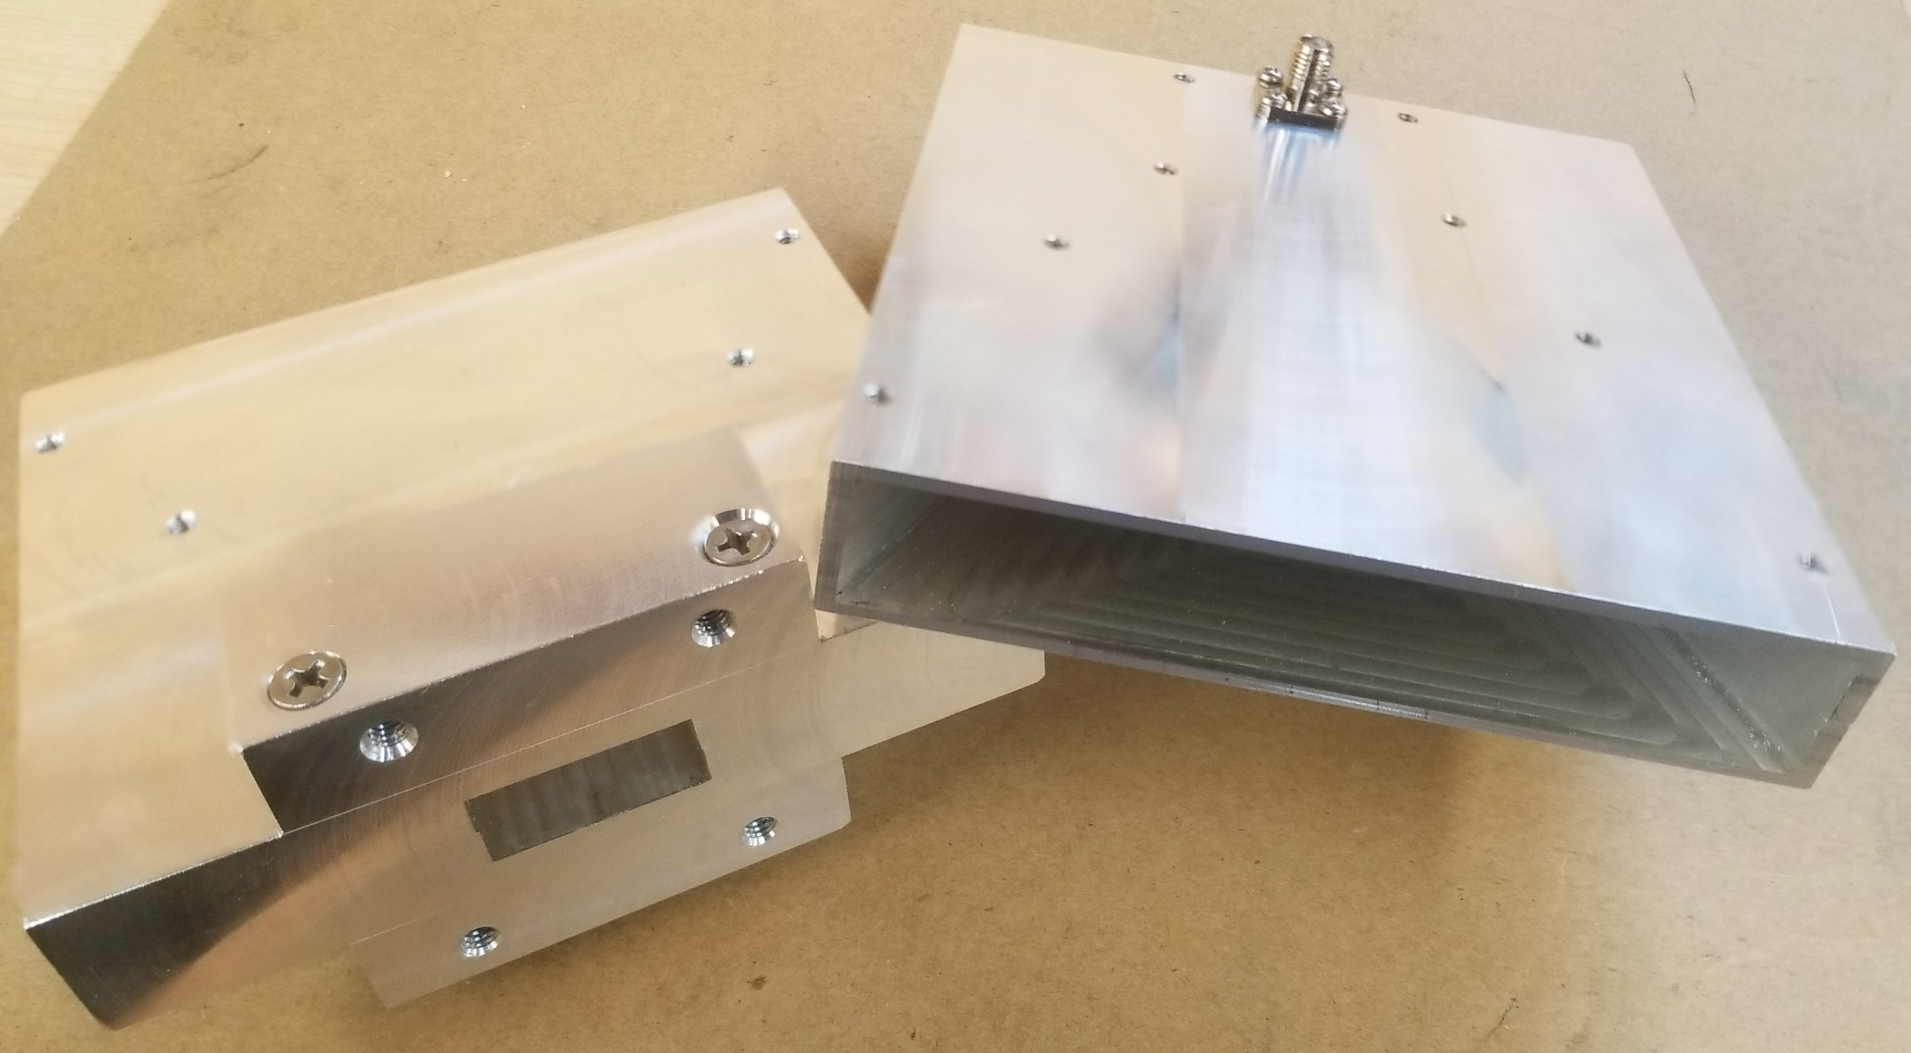
10 GHz – coax orWR-90 waveguide

Slide 12
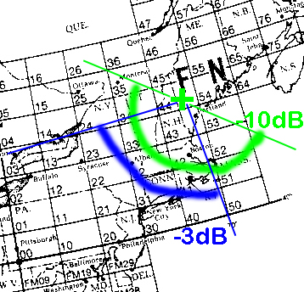
FN44rc Sectoral Coverage

Slide 13
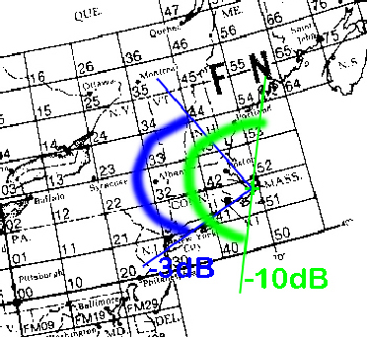
FN41 Cape Cod – Sectoral Coverage

Slide 14
47 GHz Beacons
2018? – Threat to 47 GHz allocation
Proposal – beacons to demonstrate band activity
WA1MBA – 47 GHz quadrupler project
Tom asked if could make slot antenna – NO
How about a Sectoral Horn?

Slide 15
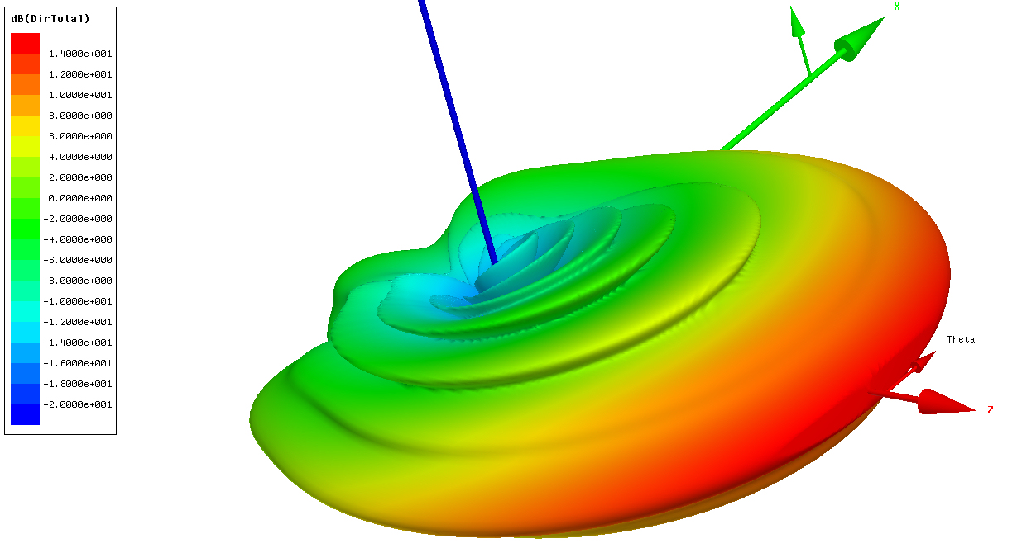
47 GHz Sectoral Horn E = 0.56λ H = 7.2λ

Slide 16
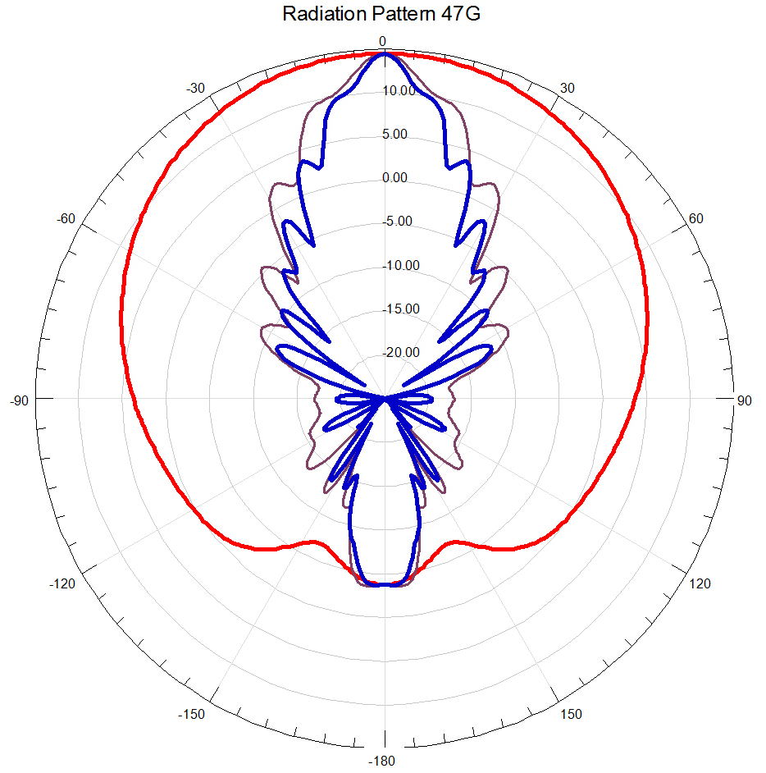
47 GHz Sectoral Horn E = 0.56λ H = 7.2λ

Slide 17
47 GHz Sectoral Horn
0.56λ = 0.140 inches
WR-28 waveguide height = 0.140 inches
No height taper – easier machining
WR-28 waveguide works at 47 and 24 GHz

Slide 18
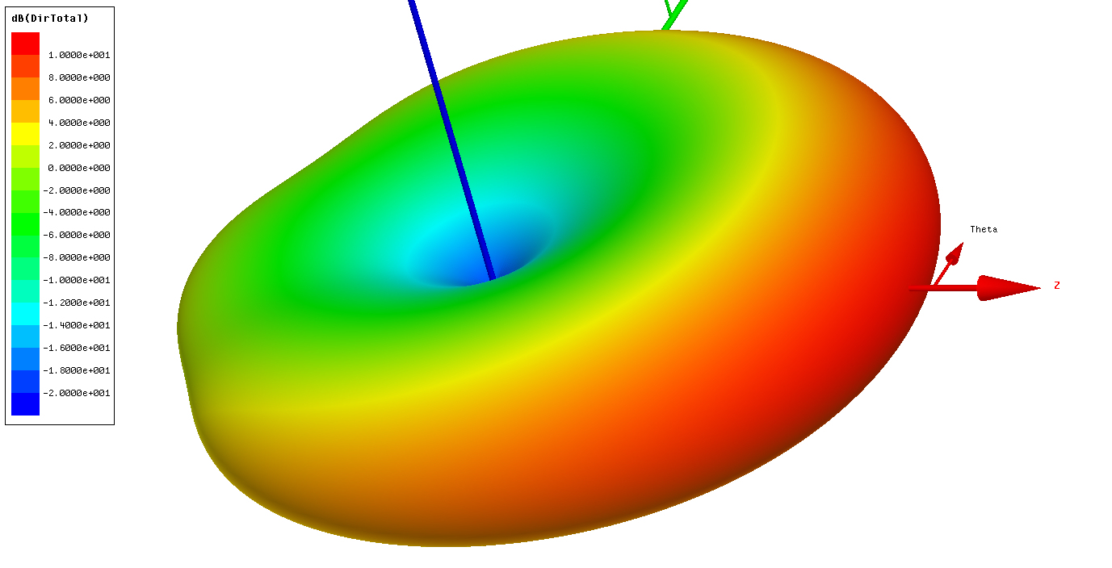
47 GHz Sectoral Horn at 24 GHz

Slide 19
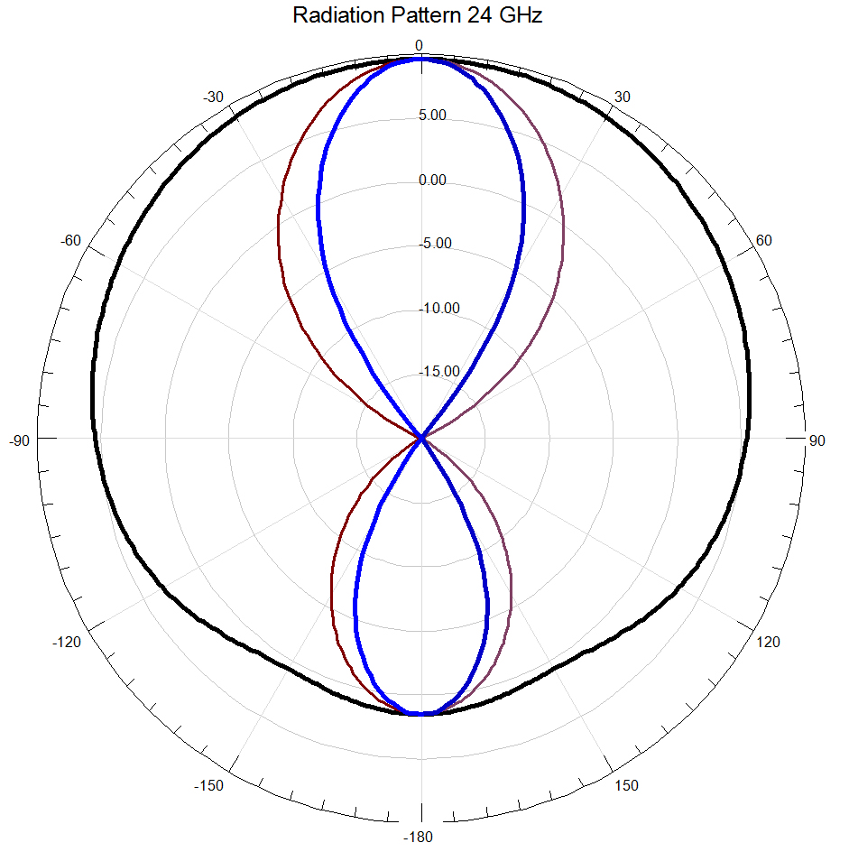
47 GHz Sectoral Horn at 24 GHz

Slide 20
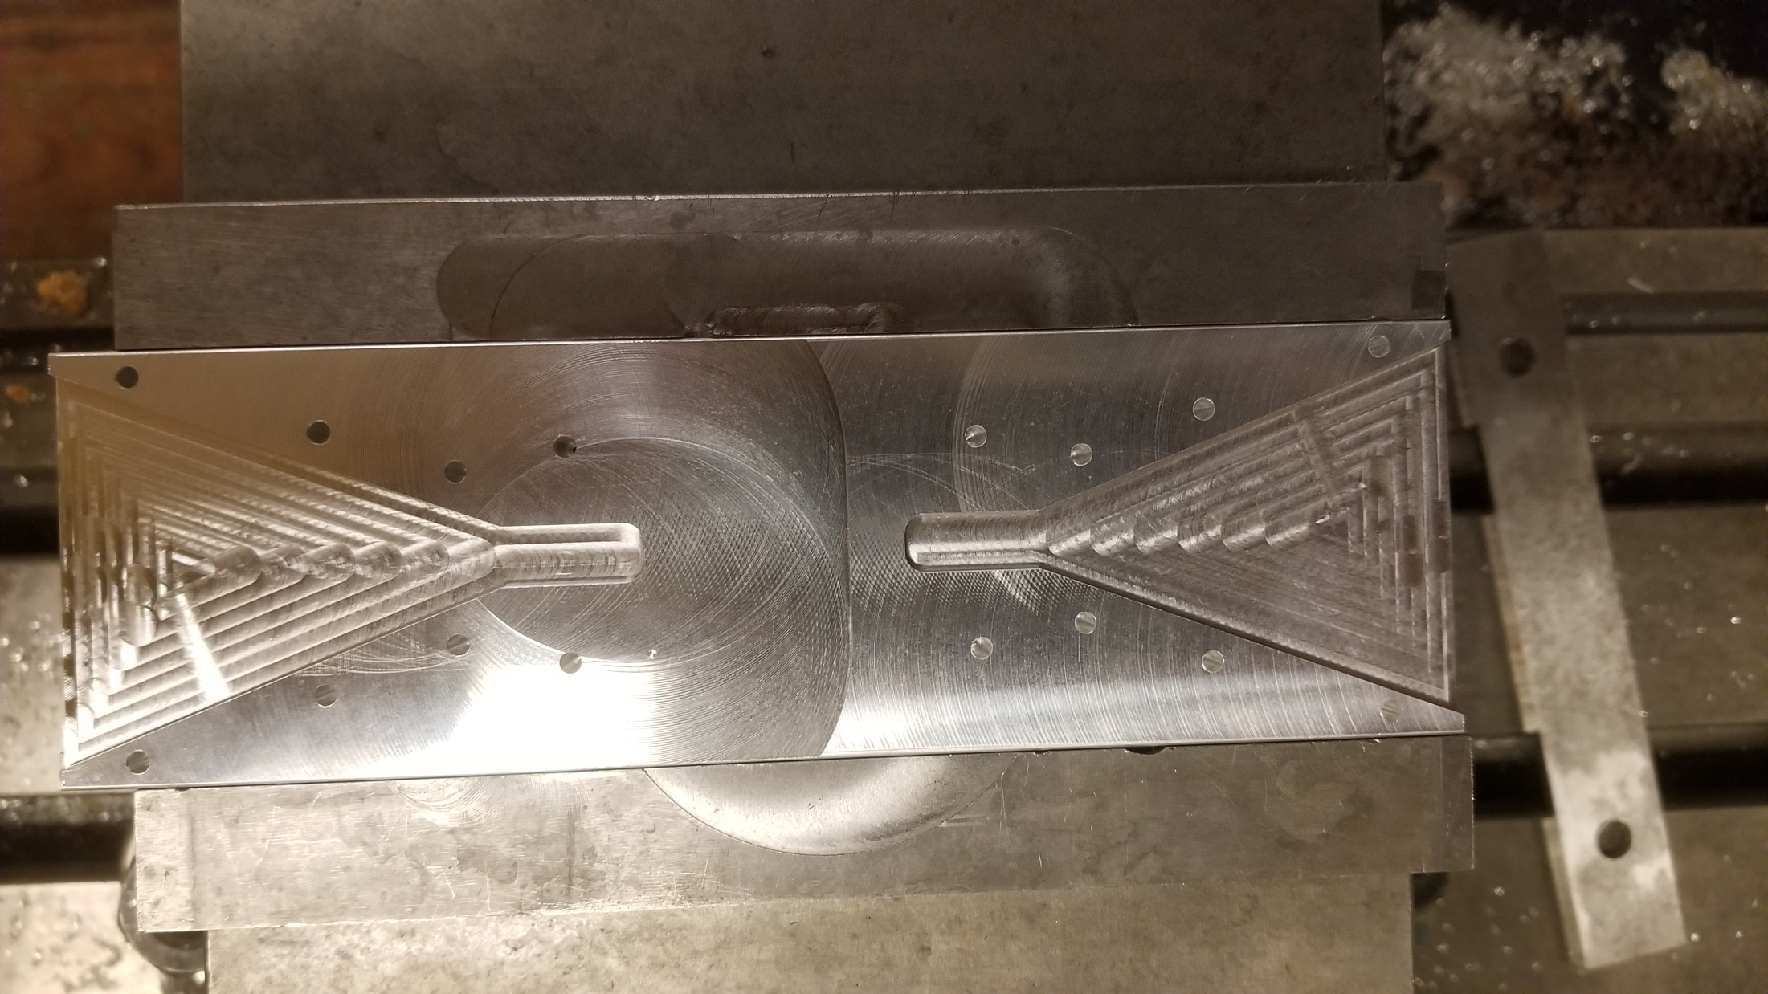
Machine two identical halves

Slide 21
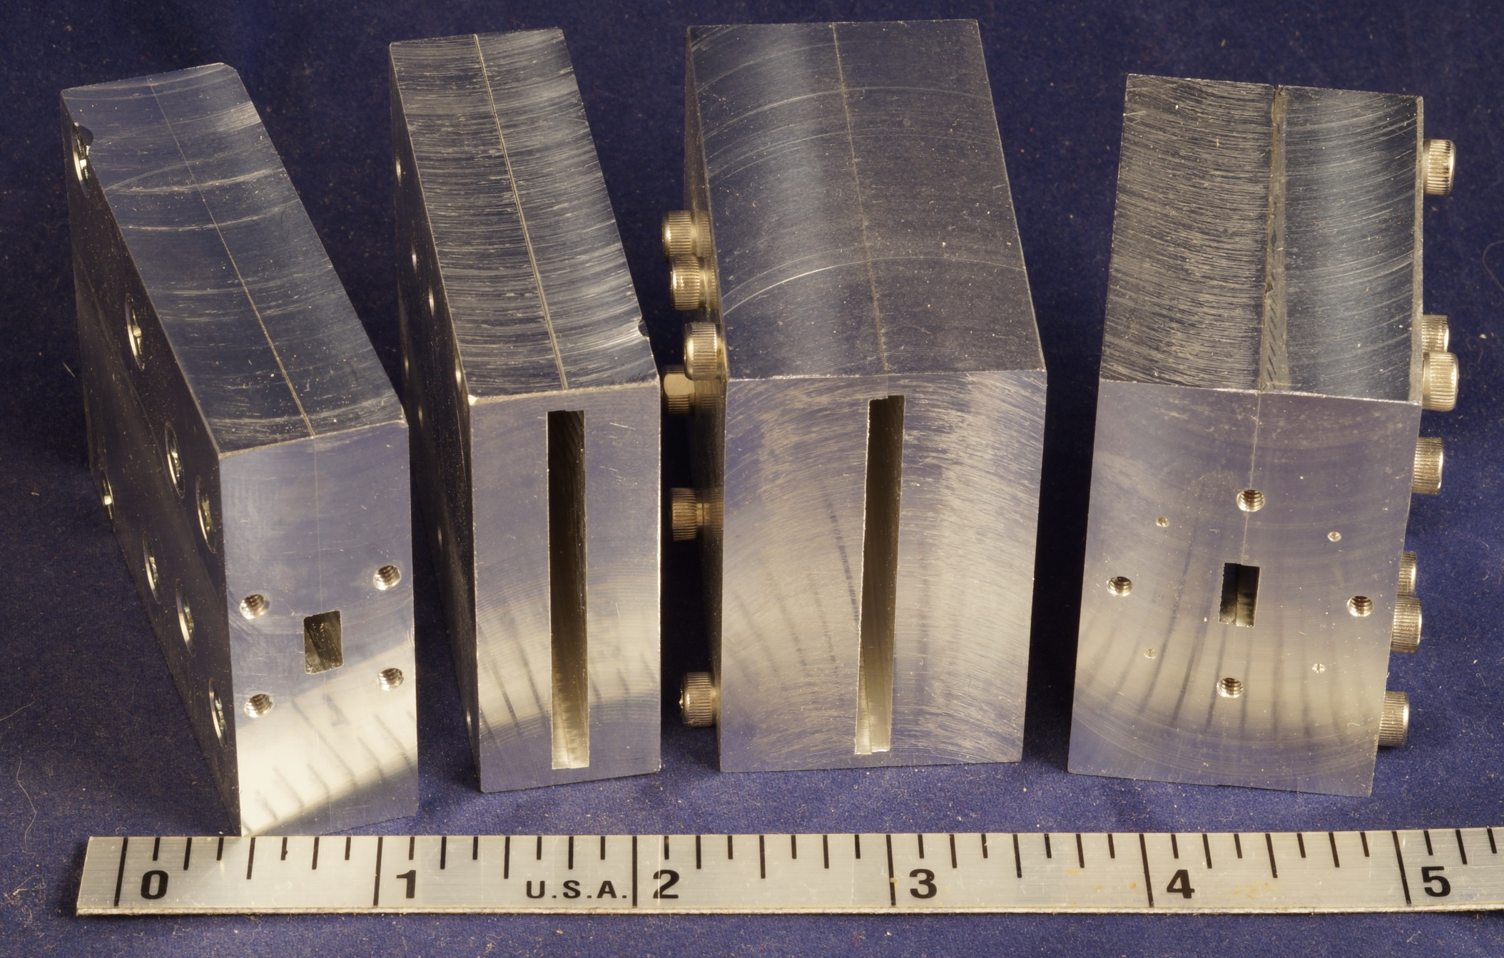
WR-28 Square or Round Flange

Slide 22
Waveguide Matching
47 GHz
WA1MBA Quadrupler has WR-22 output
WR-28 to WR-22 connection RL ~ 21 dB
Not worth further matching
24 GHz
WR-28 to WR-42 connection RL ~ 15 dB
(VSWR = 1.4)
Matching plate might be useful

Slide 23
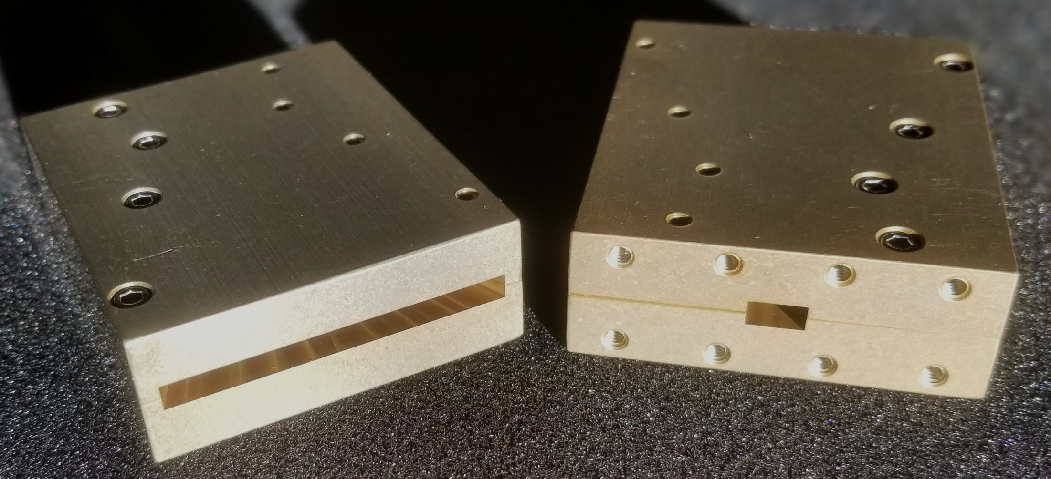
Production Horns for 47 or 24 GHz

Slide 24
Where can I get one?
Sectoral Horns for 24 or 47 GHz – Available NOW

Slide 25
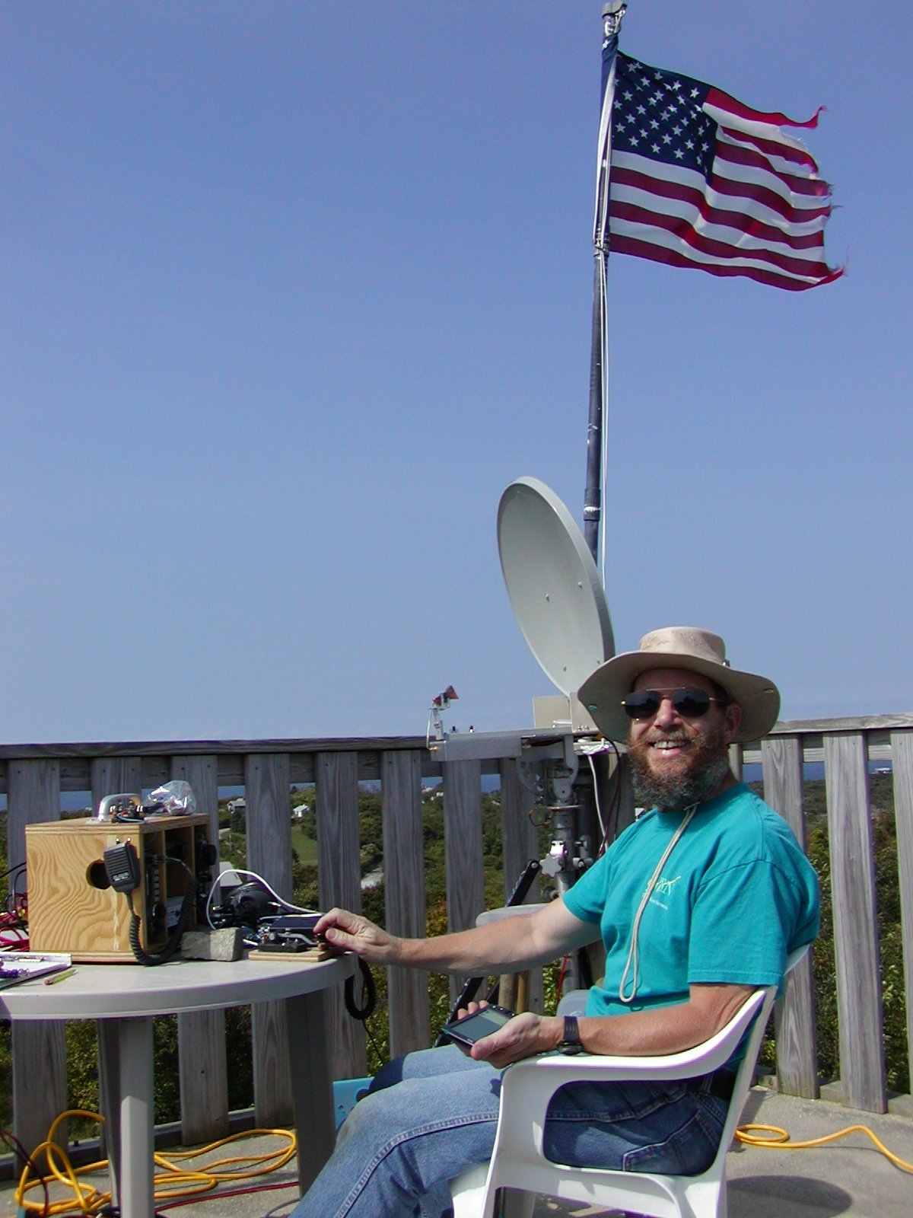
www.w1ghz.org

